Slide 1

Status of short-term rentals in Tillamook county unincorporated communities
SARAH ABSHER, CFM, DIRECTOR
TILLAMOOK COUNTY DEPARTMENT OF COMMUNITY DEVELOPMENT

Slide 2
2018 SCOPE OF STUDY
OCEANSIDE
NETARTS
PACIFIC CITY/WOODS
NESKOWIN

Slide 3
2021 SCOPE OF STUDY
NEAHKAHIE
BARVIEW/TWIN ROCKS/WATSECO
OCEANSIDE
NETARTS
CAPE MEARES
PACIFIC CITY/WOODS
NESKOWIN

Slide 4
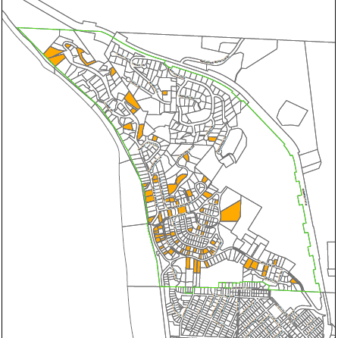
NEAHKAHNIE
18%
RESIDENTIAL IMPROVEMENTS AT VALUE > $50K
385
SHORT-TERM RENTALS
69

Slide 5
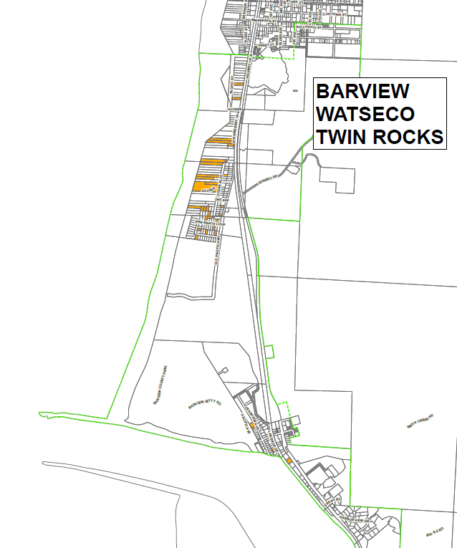
BARVIEW
TWIN ROCKS
WATSECO
16%
RESIDENTIAL IMPROVEMENTS AT VALUE > $50K
234
SHORT-TERM RENTALS
37

Slide 6
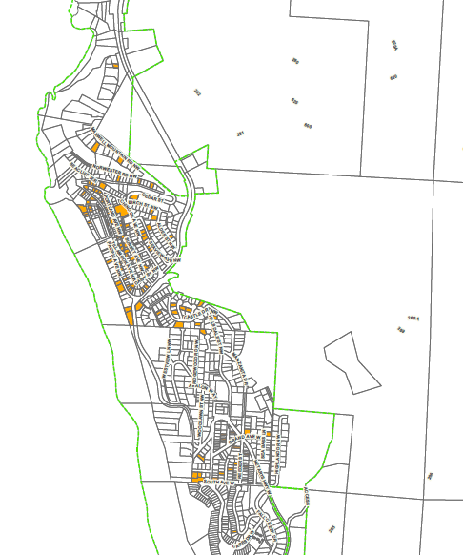
OCEANSIDE
16%
RESIDENTIAL IMPROVEMENTS AT VALUE > $50K
672
SHORT-TERM RENTALS
109

Slide 7
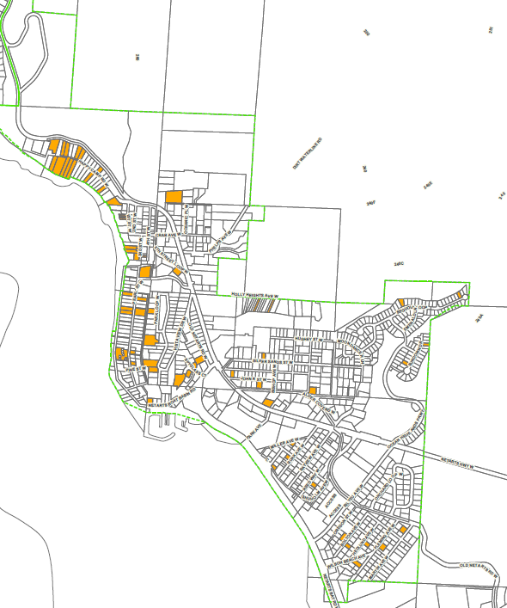
NETARTS
12%
RESIDENTIAL IMPROVEMENTS AT VALUE > $50K
609
SHORT-TERM RENTALS
75

Slide 8
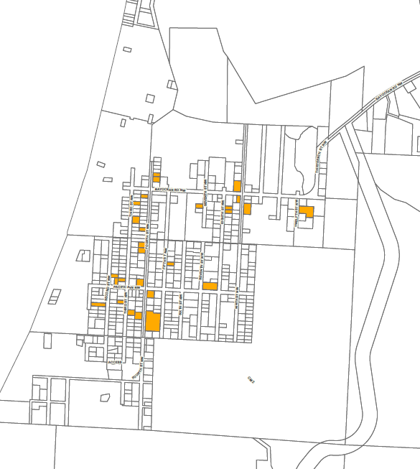
CAPE MEARES
13%
RESIDENTIAL IMPROVEMENTS AT VALUE > $50K
205
SHORT-TERM RENTALS
27

Slide 9
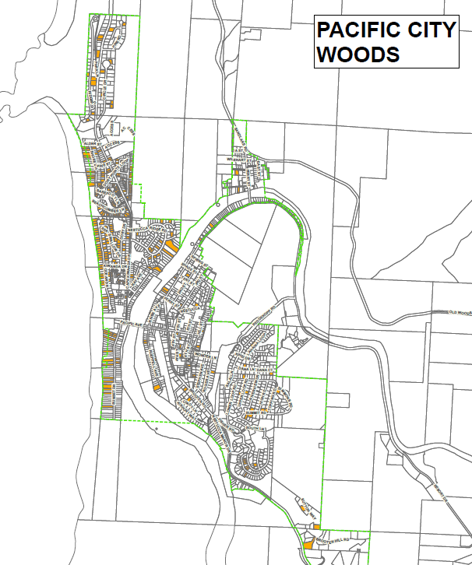
PACIFIC CITY/WOODS
22%
RESIDENTIAL IMPROVEMENTS AT VALUE > $50K
1288
SHORT-TERM RENTALS
278

Slide 10
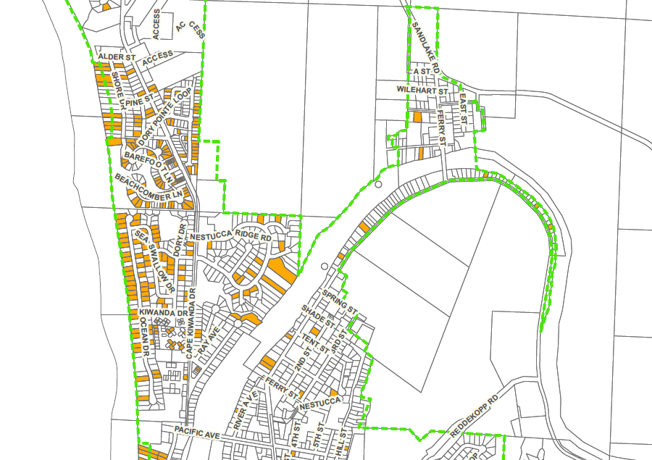
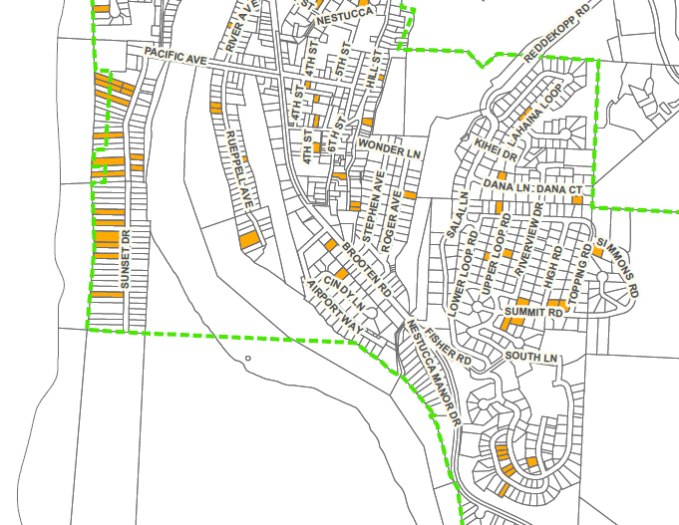
COMPARISON BY LOCATION
SOUTH PACIFIC AVE. BRIDGE
NORTH PACIFIC AVE. BRIDGE

Slide 11
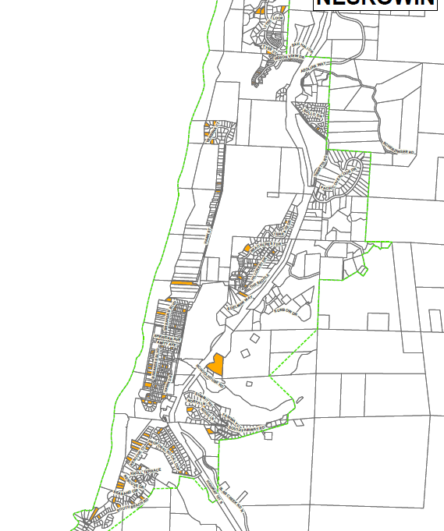
NESKOWIN
16%
RESIDENTIAL IMPROVEMENTS AT VALUE > $50K
874
SHORT-TERM RENTALS
138

Slide 12
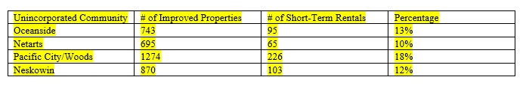
2018 STR NUMBERS BY UNINCORPORATED COMMUNITY

Slide 13
2018/2021 COMPARISON
UNINCORPORATED COMMUNITY | OCEANSIDE | NETARTS | PACIFIC CITY/WOODS | NESKOWIN
2018 | 95 STRS | 65 STRS | 226 STRS | 103 STRS
2021 | 109 STRS | 75 STRS | 278 STRS | 138 STRS
UNINCORPORATED COMMUNITY | OCEANSIDE | NETARTS | PACIFIC CITY/WOODS | NESKOWIN
2018 | 95 | 65 | 226 | 103
2021 | 109 | 75 | 278 | 138
INCREASE | 14 | 10 | 52 | 35

Slide 14

QUESTIONS & COMMENTS

