Slide 1

Pine Beach Combined Application for Shoreline Protection
Tillamook County Planning Commission
May 27, 2021
Presented by:
Wendie L. Kellington, Kellington Law Group, PC
P.O. Box 159, Lake Oswego, Or 97034

Slide 2
Subject Properties
Avoiding a piecemeal approach, the owners of 15 properties working together seek approval of critically needed shoreline protection.
Proposal is supported by the Pine Beach HOA.
Pine Beach Loop (Pine Beach Subdivision – first platted 1932; replatted 1994) and Ocean Blvd. (George Shand tracts platted 1950).

Slide 3
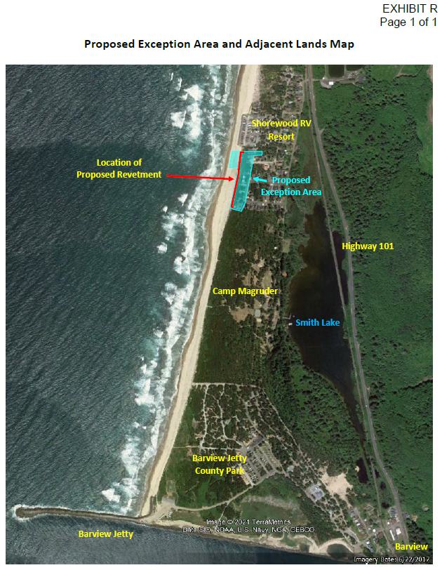

Slide 4
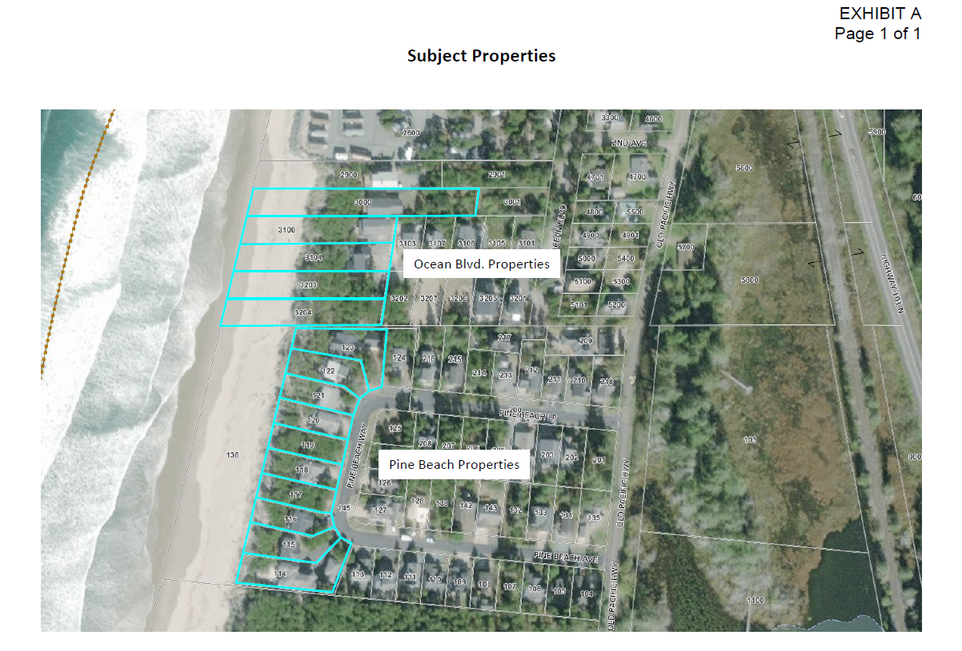

Slide 5
Why the BPS is Sought: the properties and infrastructure are in imminent peril
Retrograding beach since 1994
King Tides in 2020 and 2021 reached oceanfront homes+
Continued significant threat of flooding
At risk is not only homes, but public water and sewer infrastructure.
BPS protects public and private investments; avoids significant environmental harm from parts of destroyed homes and broken sewer and water pipes; broken electrical connections, gas connections; protects coastal dune habitat.
Water and sewer district costs of repair may be beyond district’s capacity or would cause significant strain the district’s resources.
Torn out infrastructure would cause dangerous service disruptions to the larger community.

Slide 6
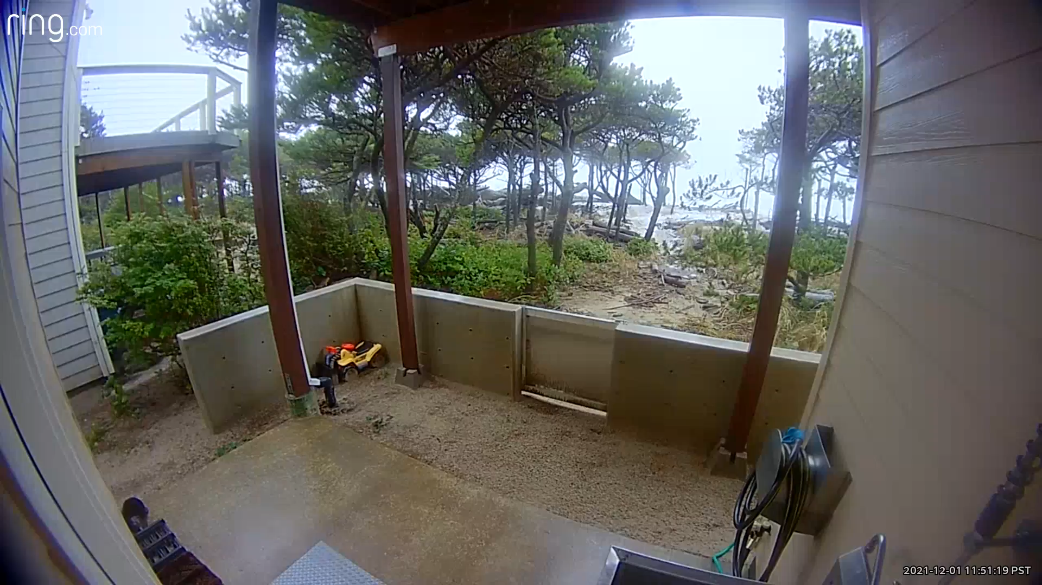
January 12, 2021 Tides Flooding Pine Beach Properties

Slide 7
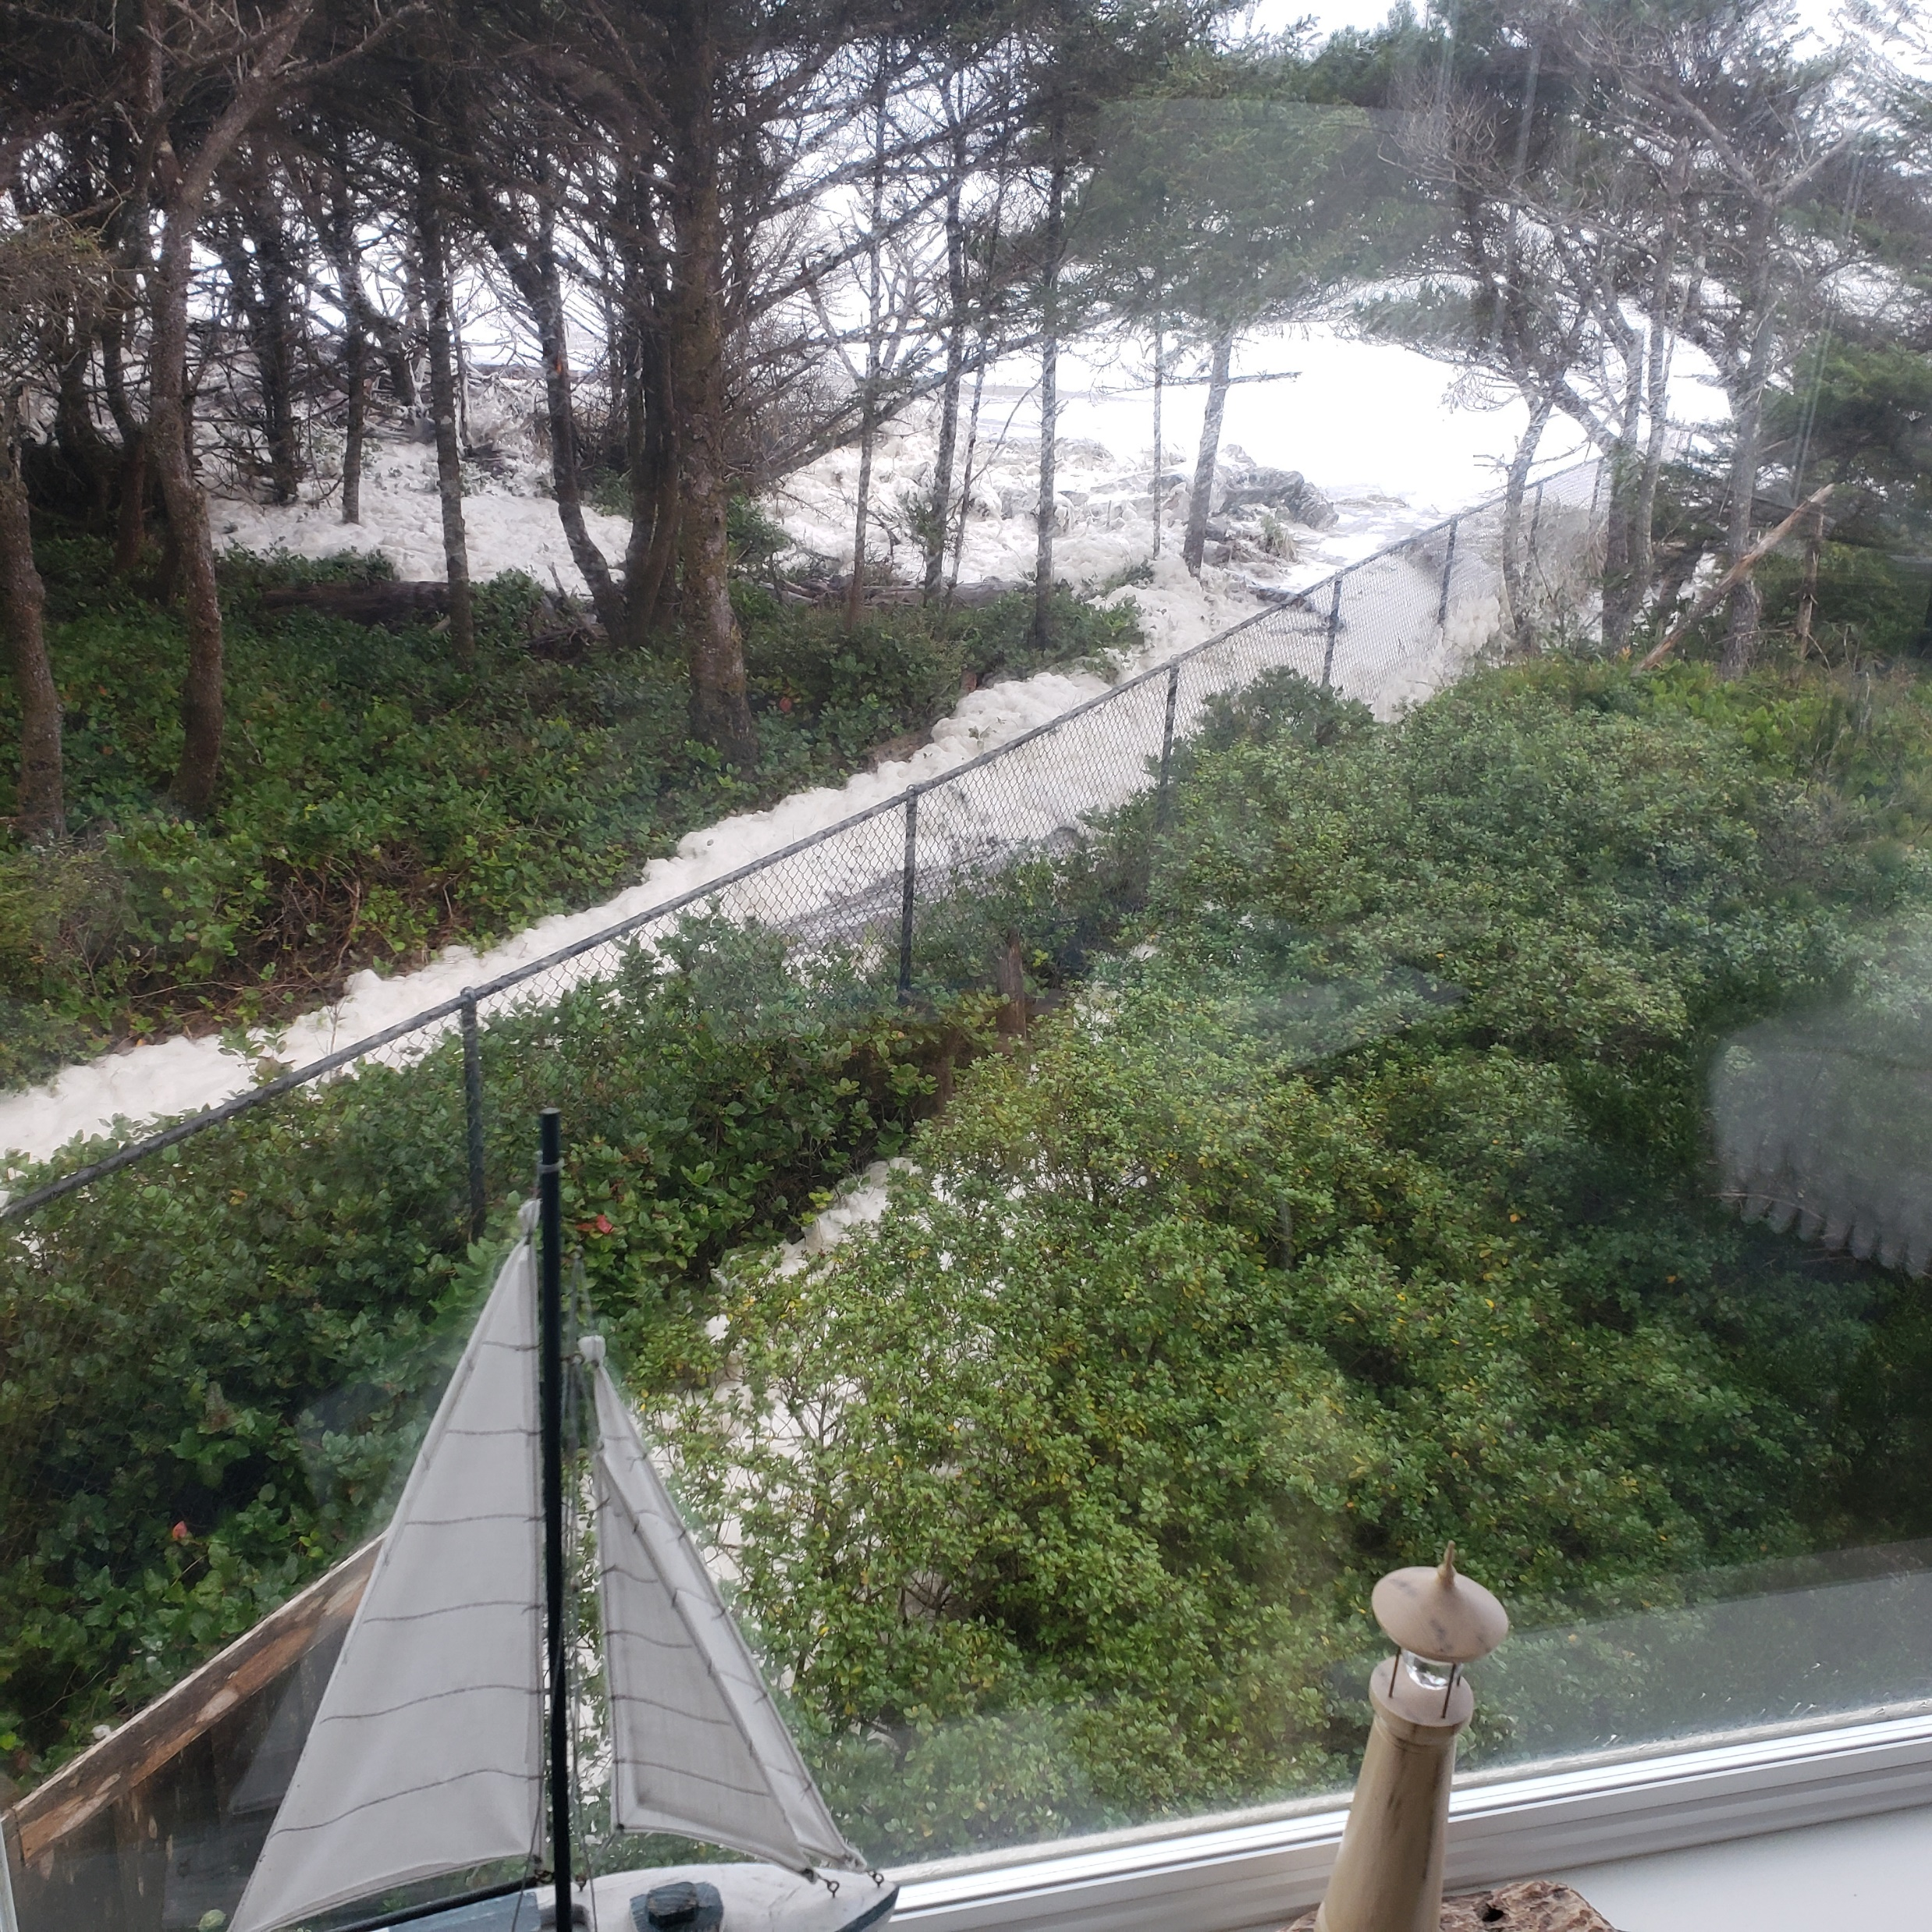

Slide 8
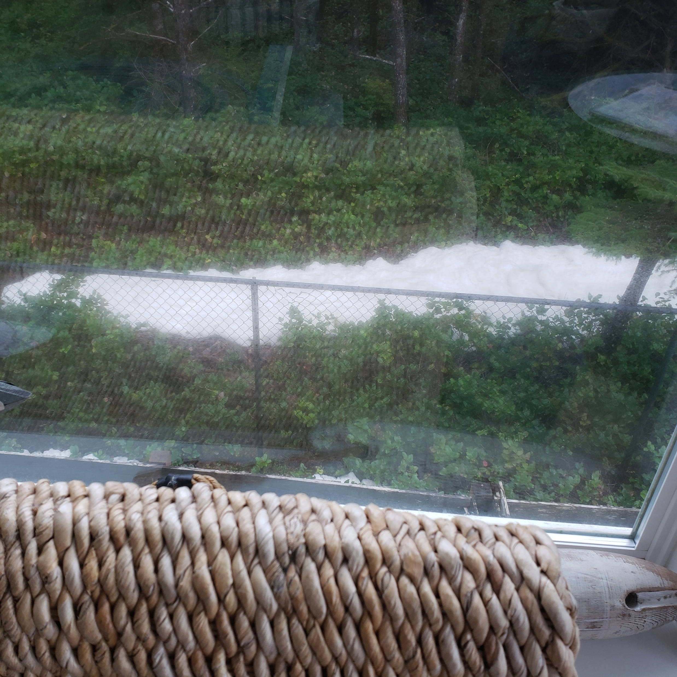

Slide 9
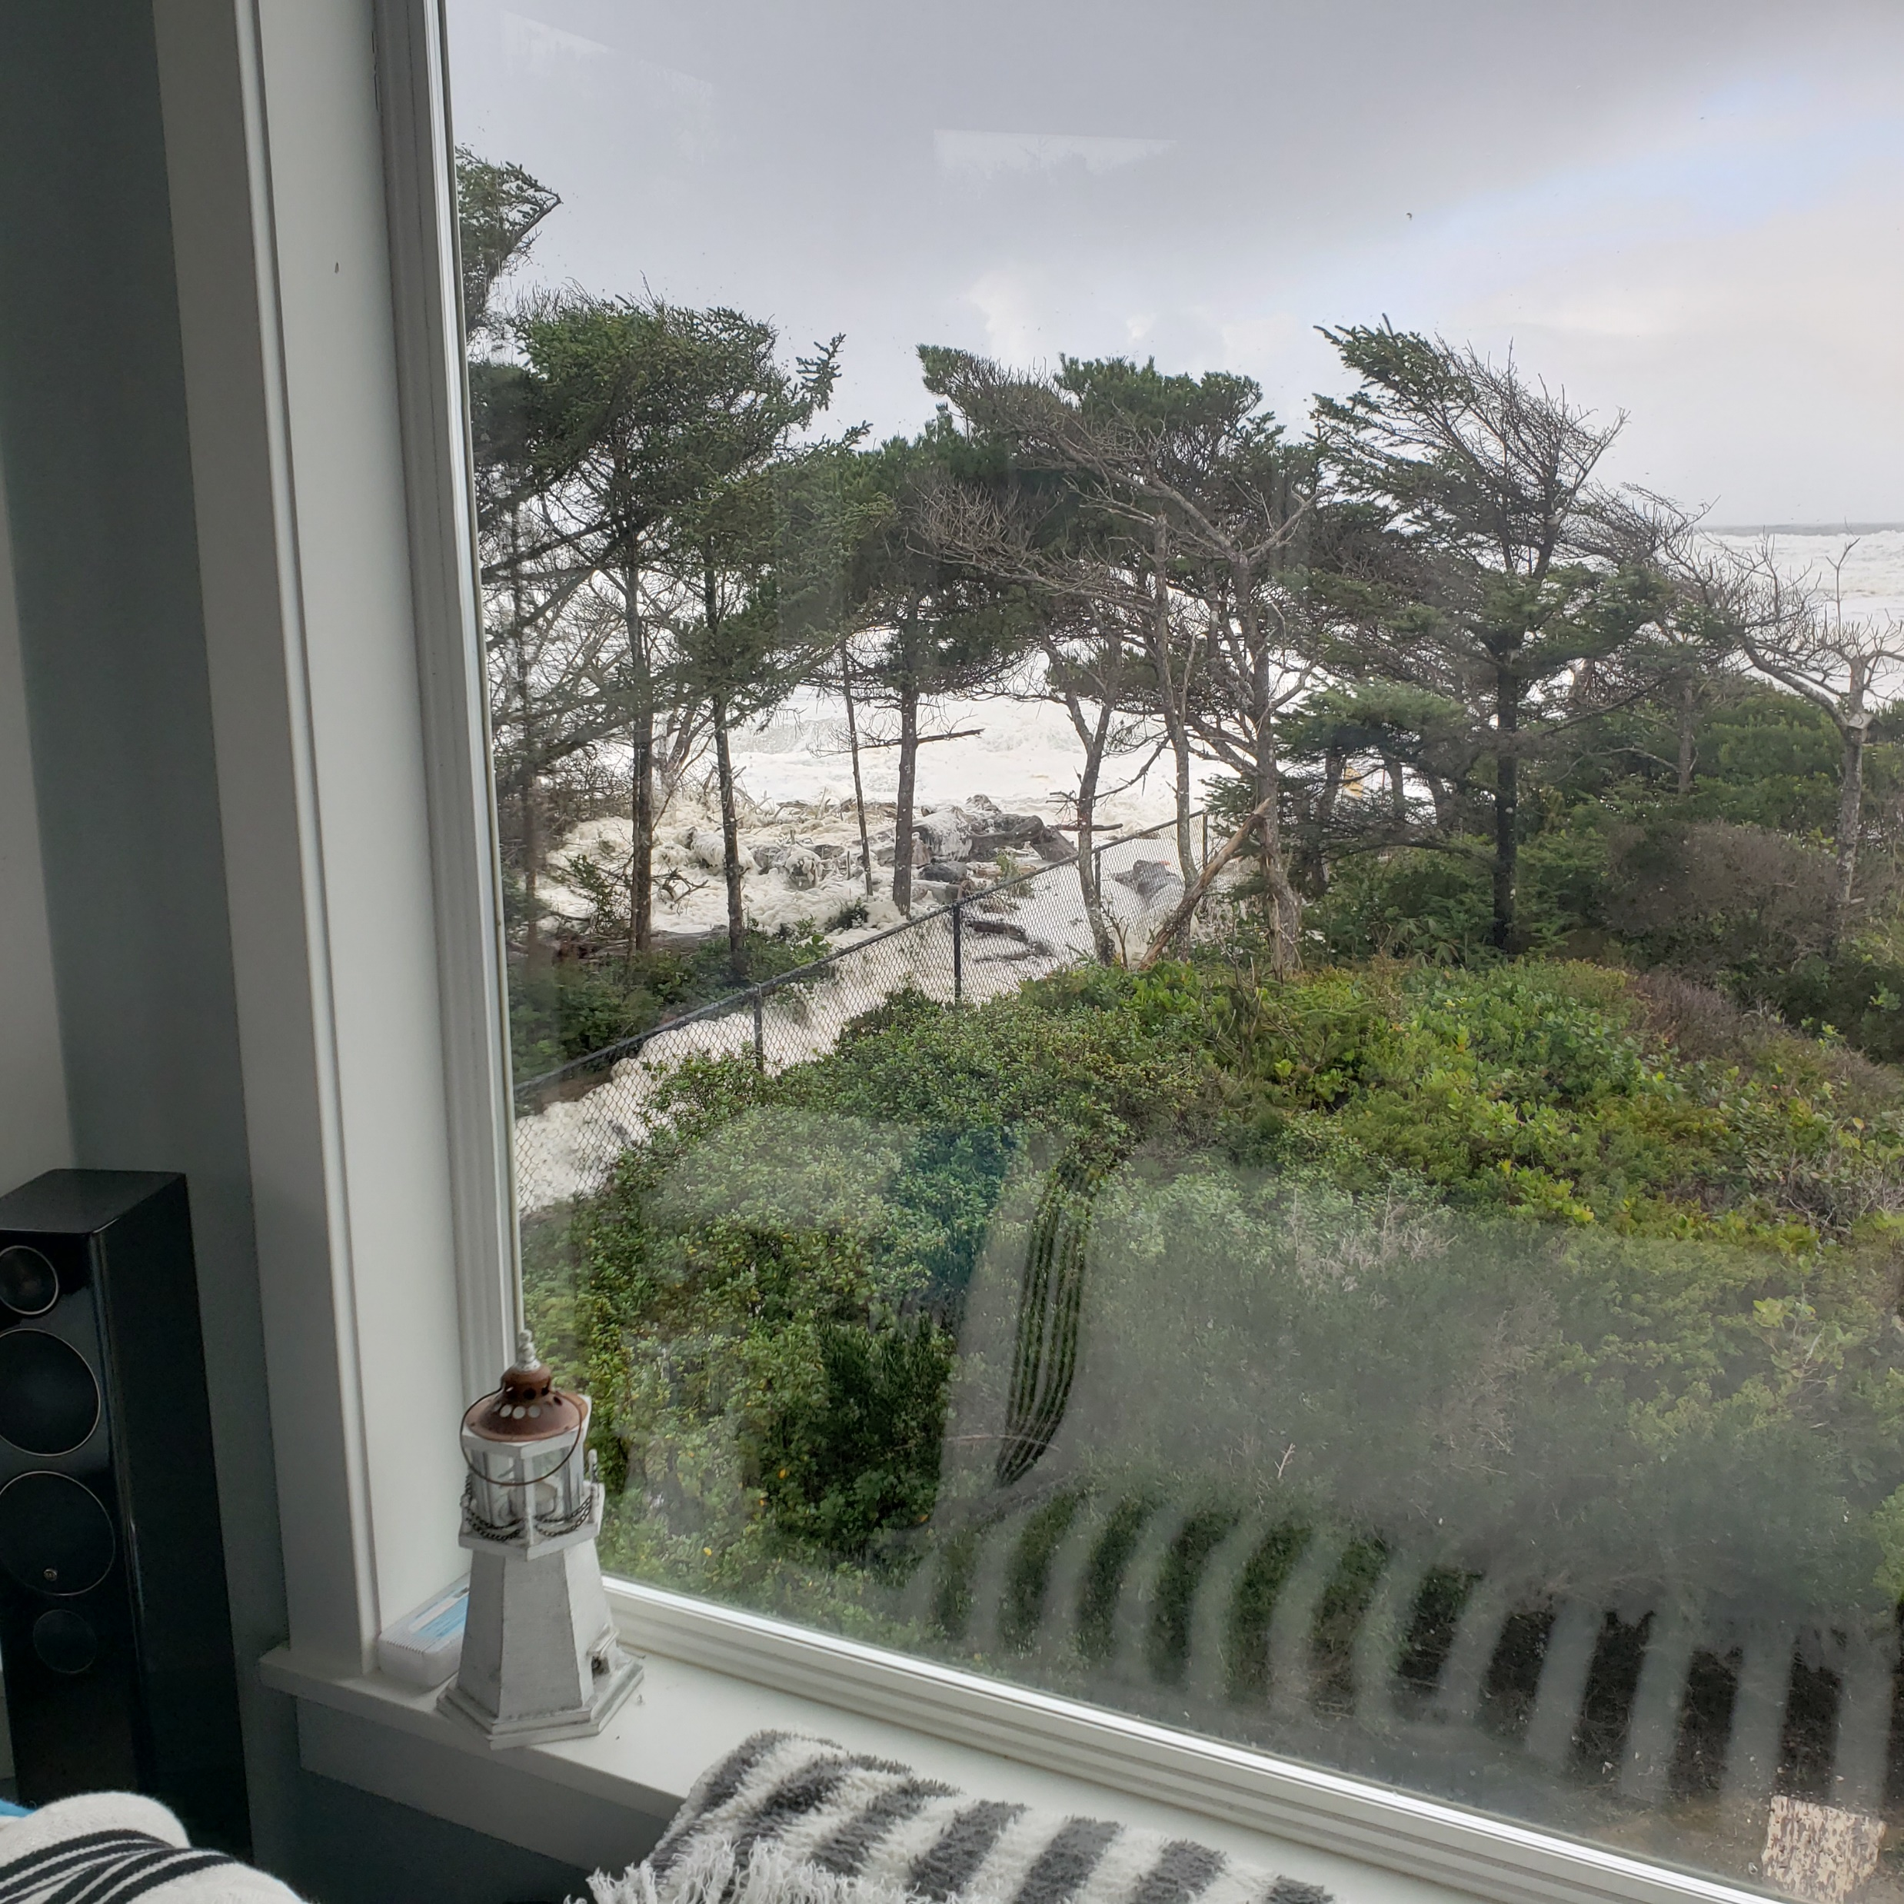

Slide 10
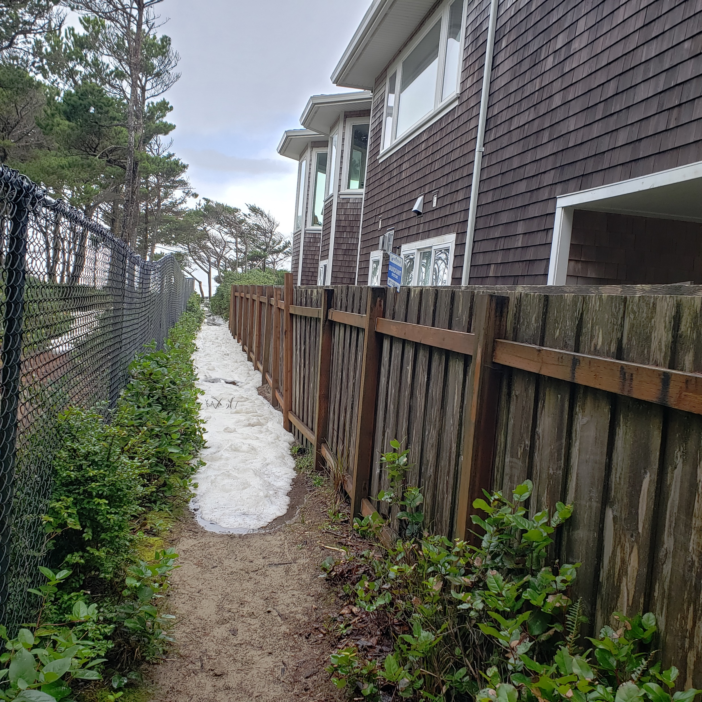

Slide 11
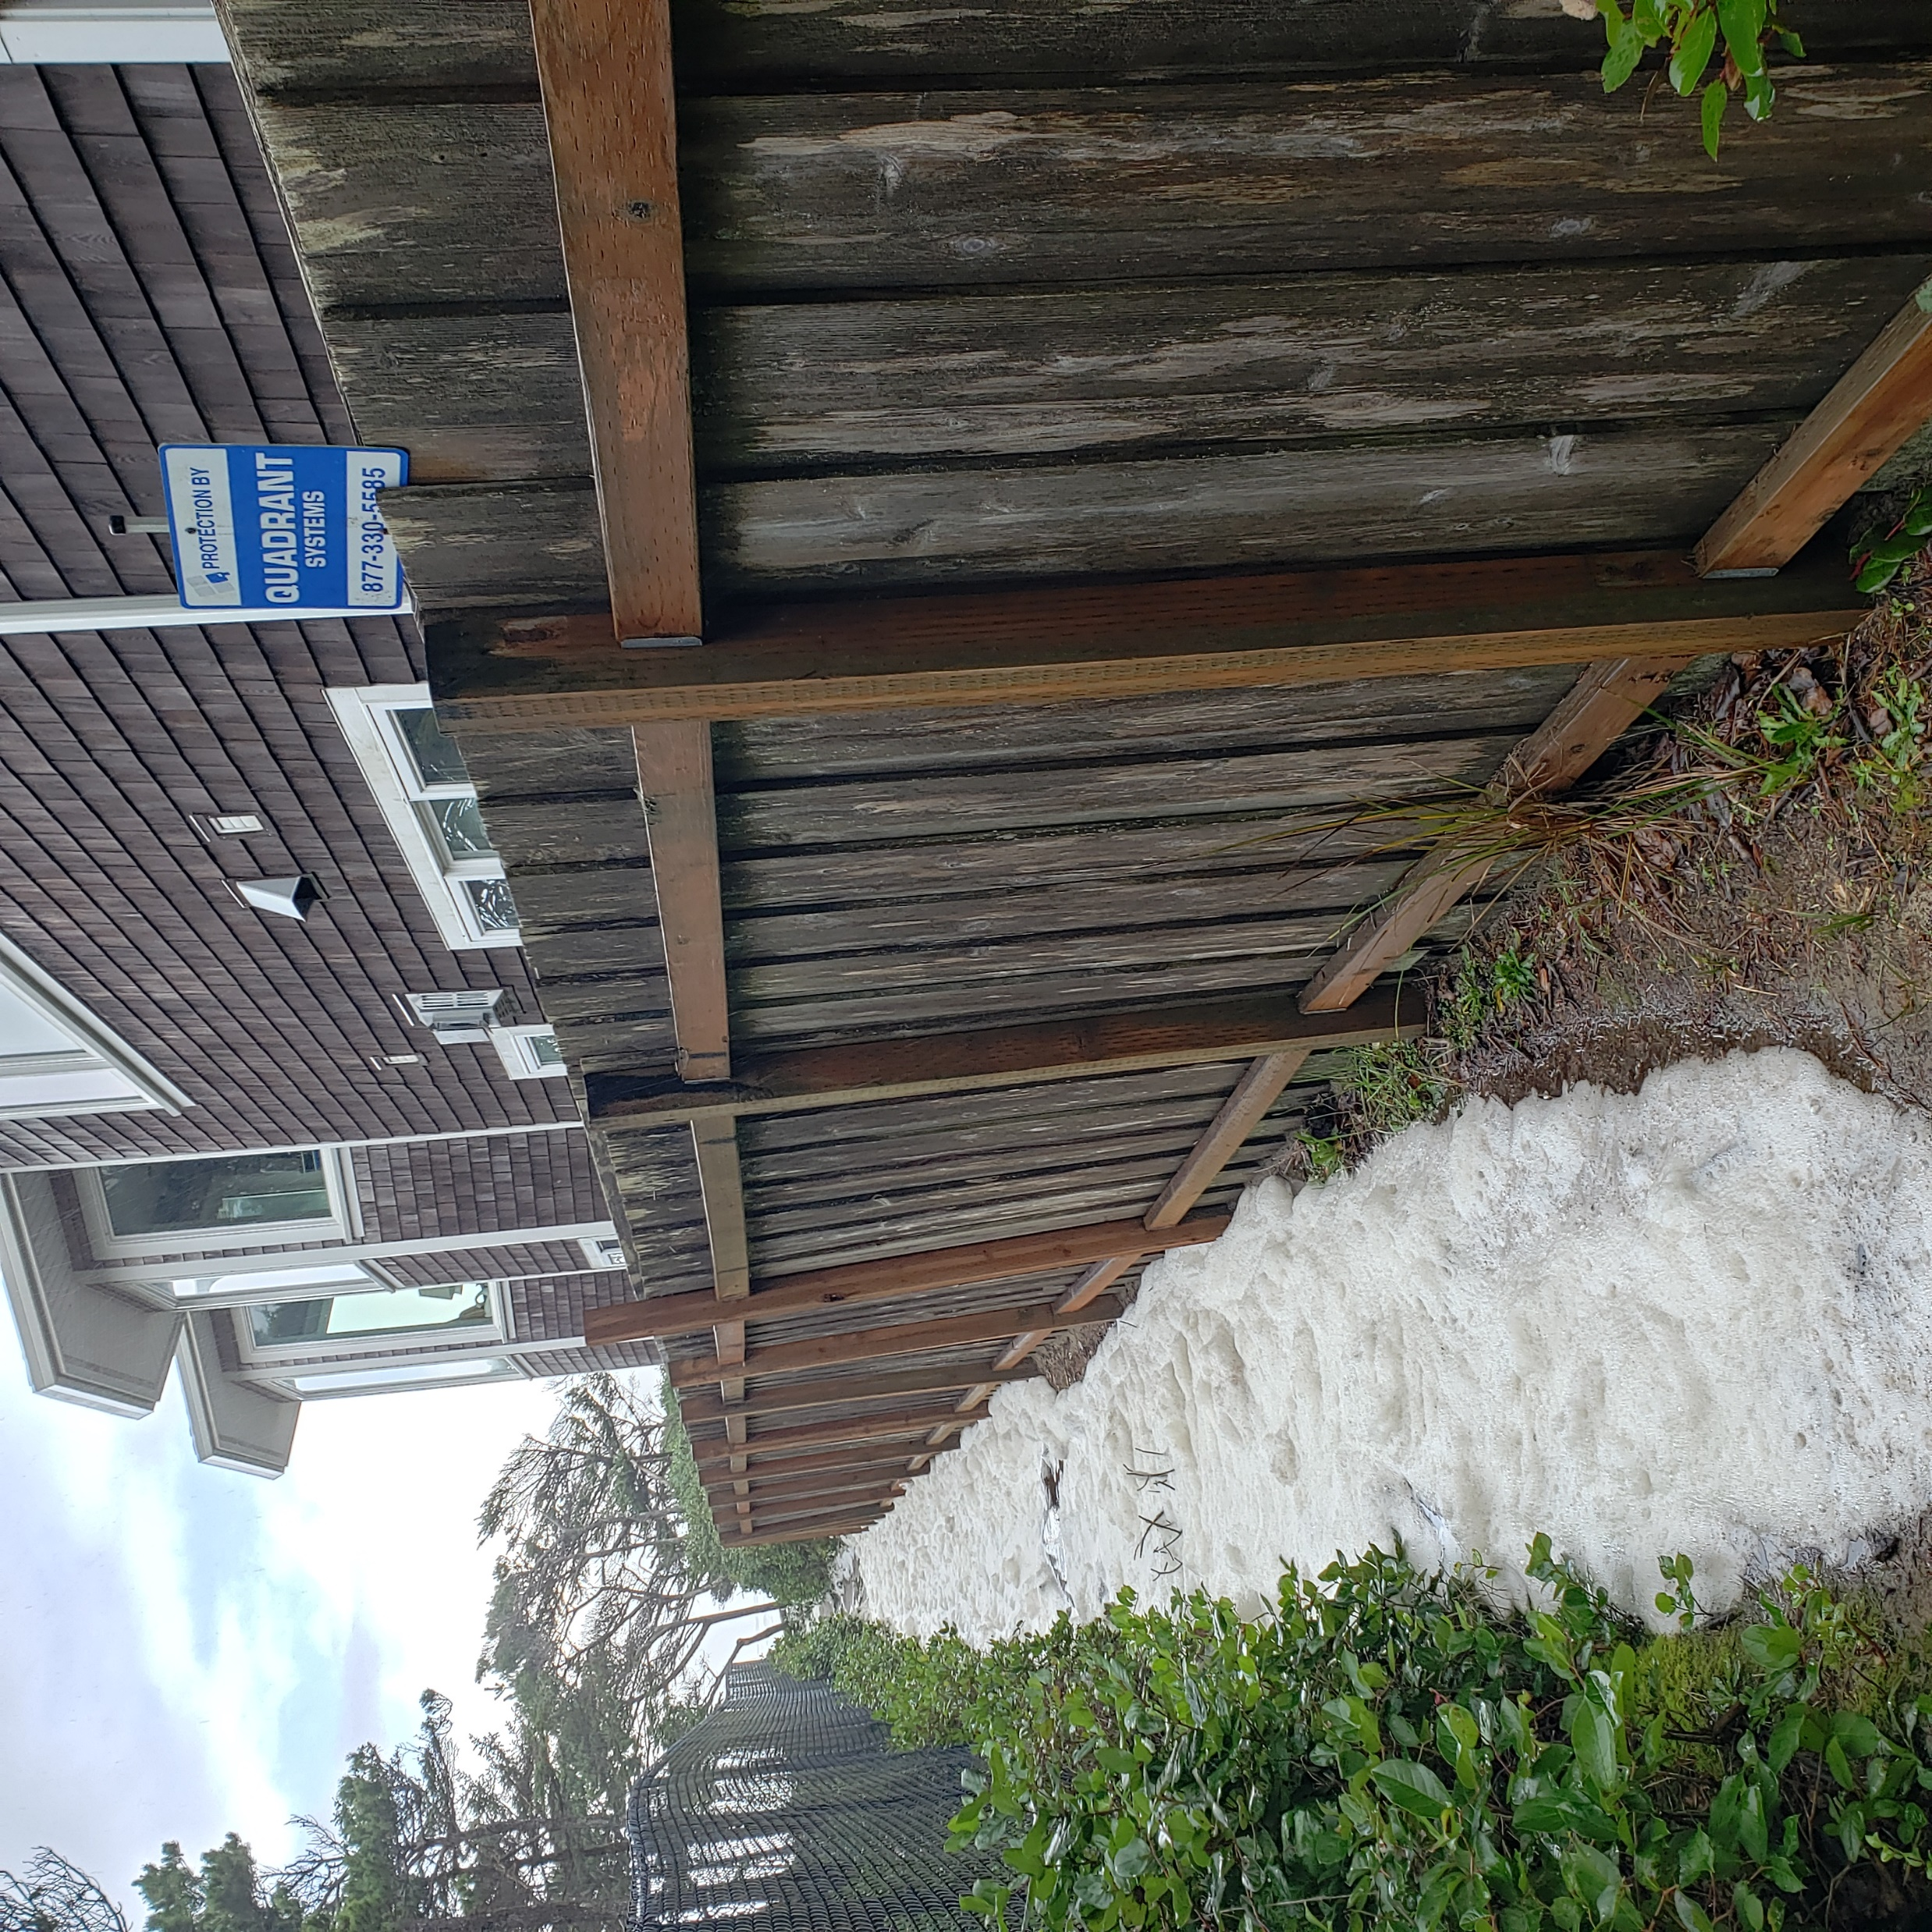

Slide 12
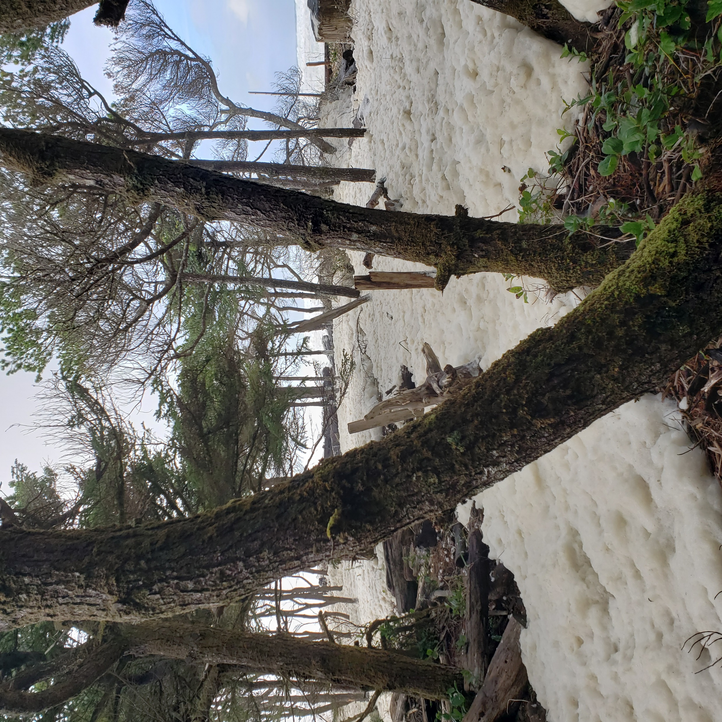

Slide 13
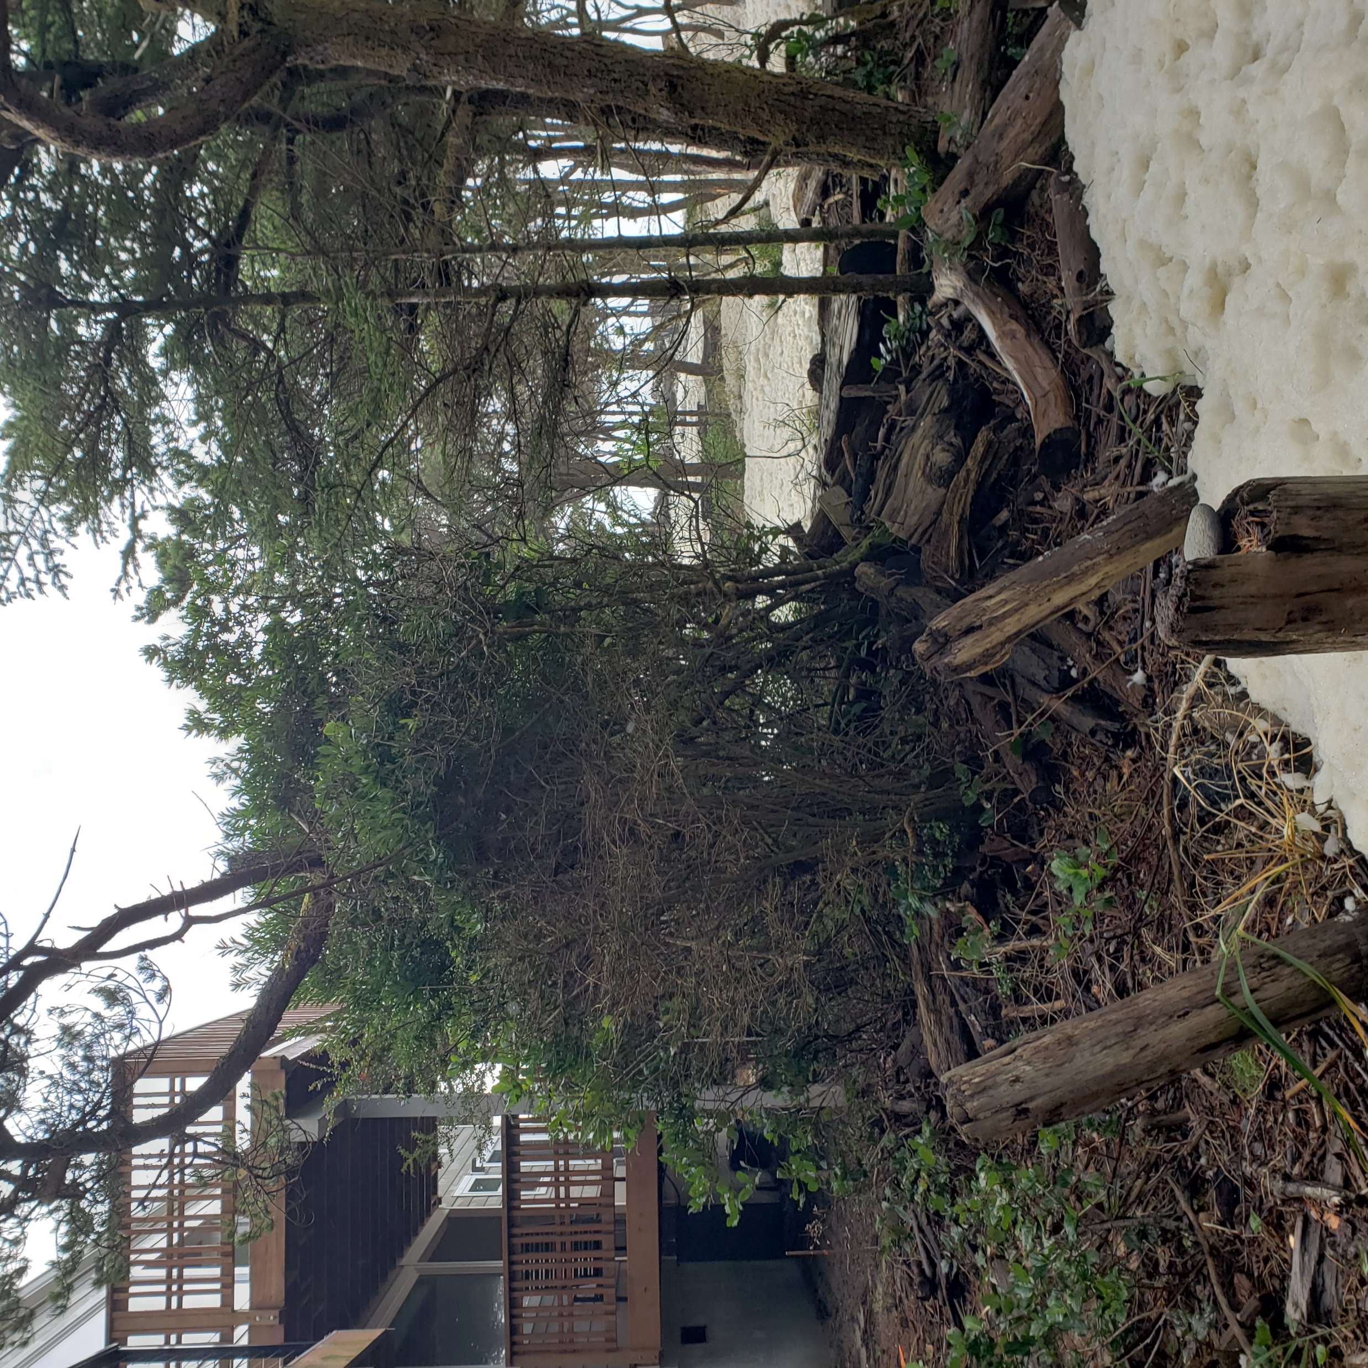

Slide 14
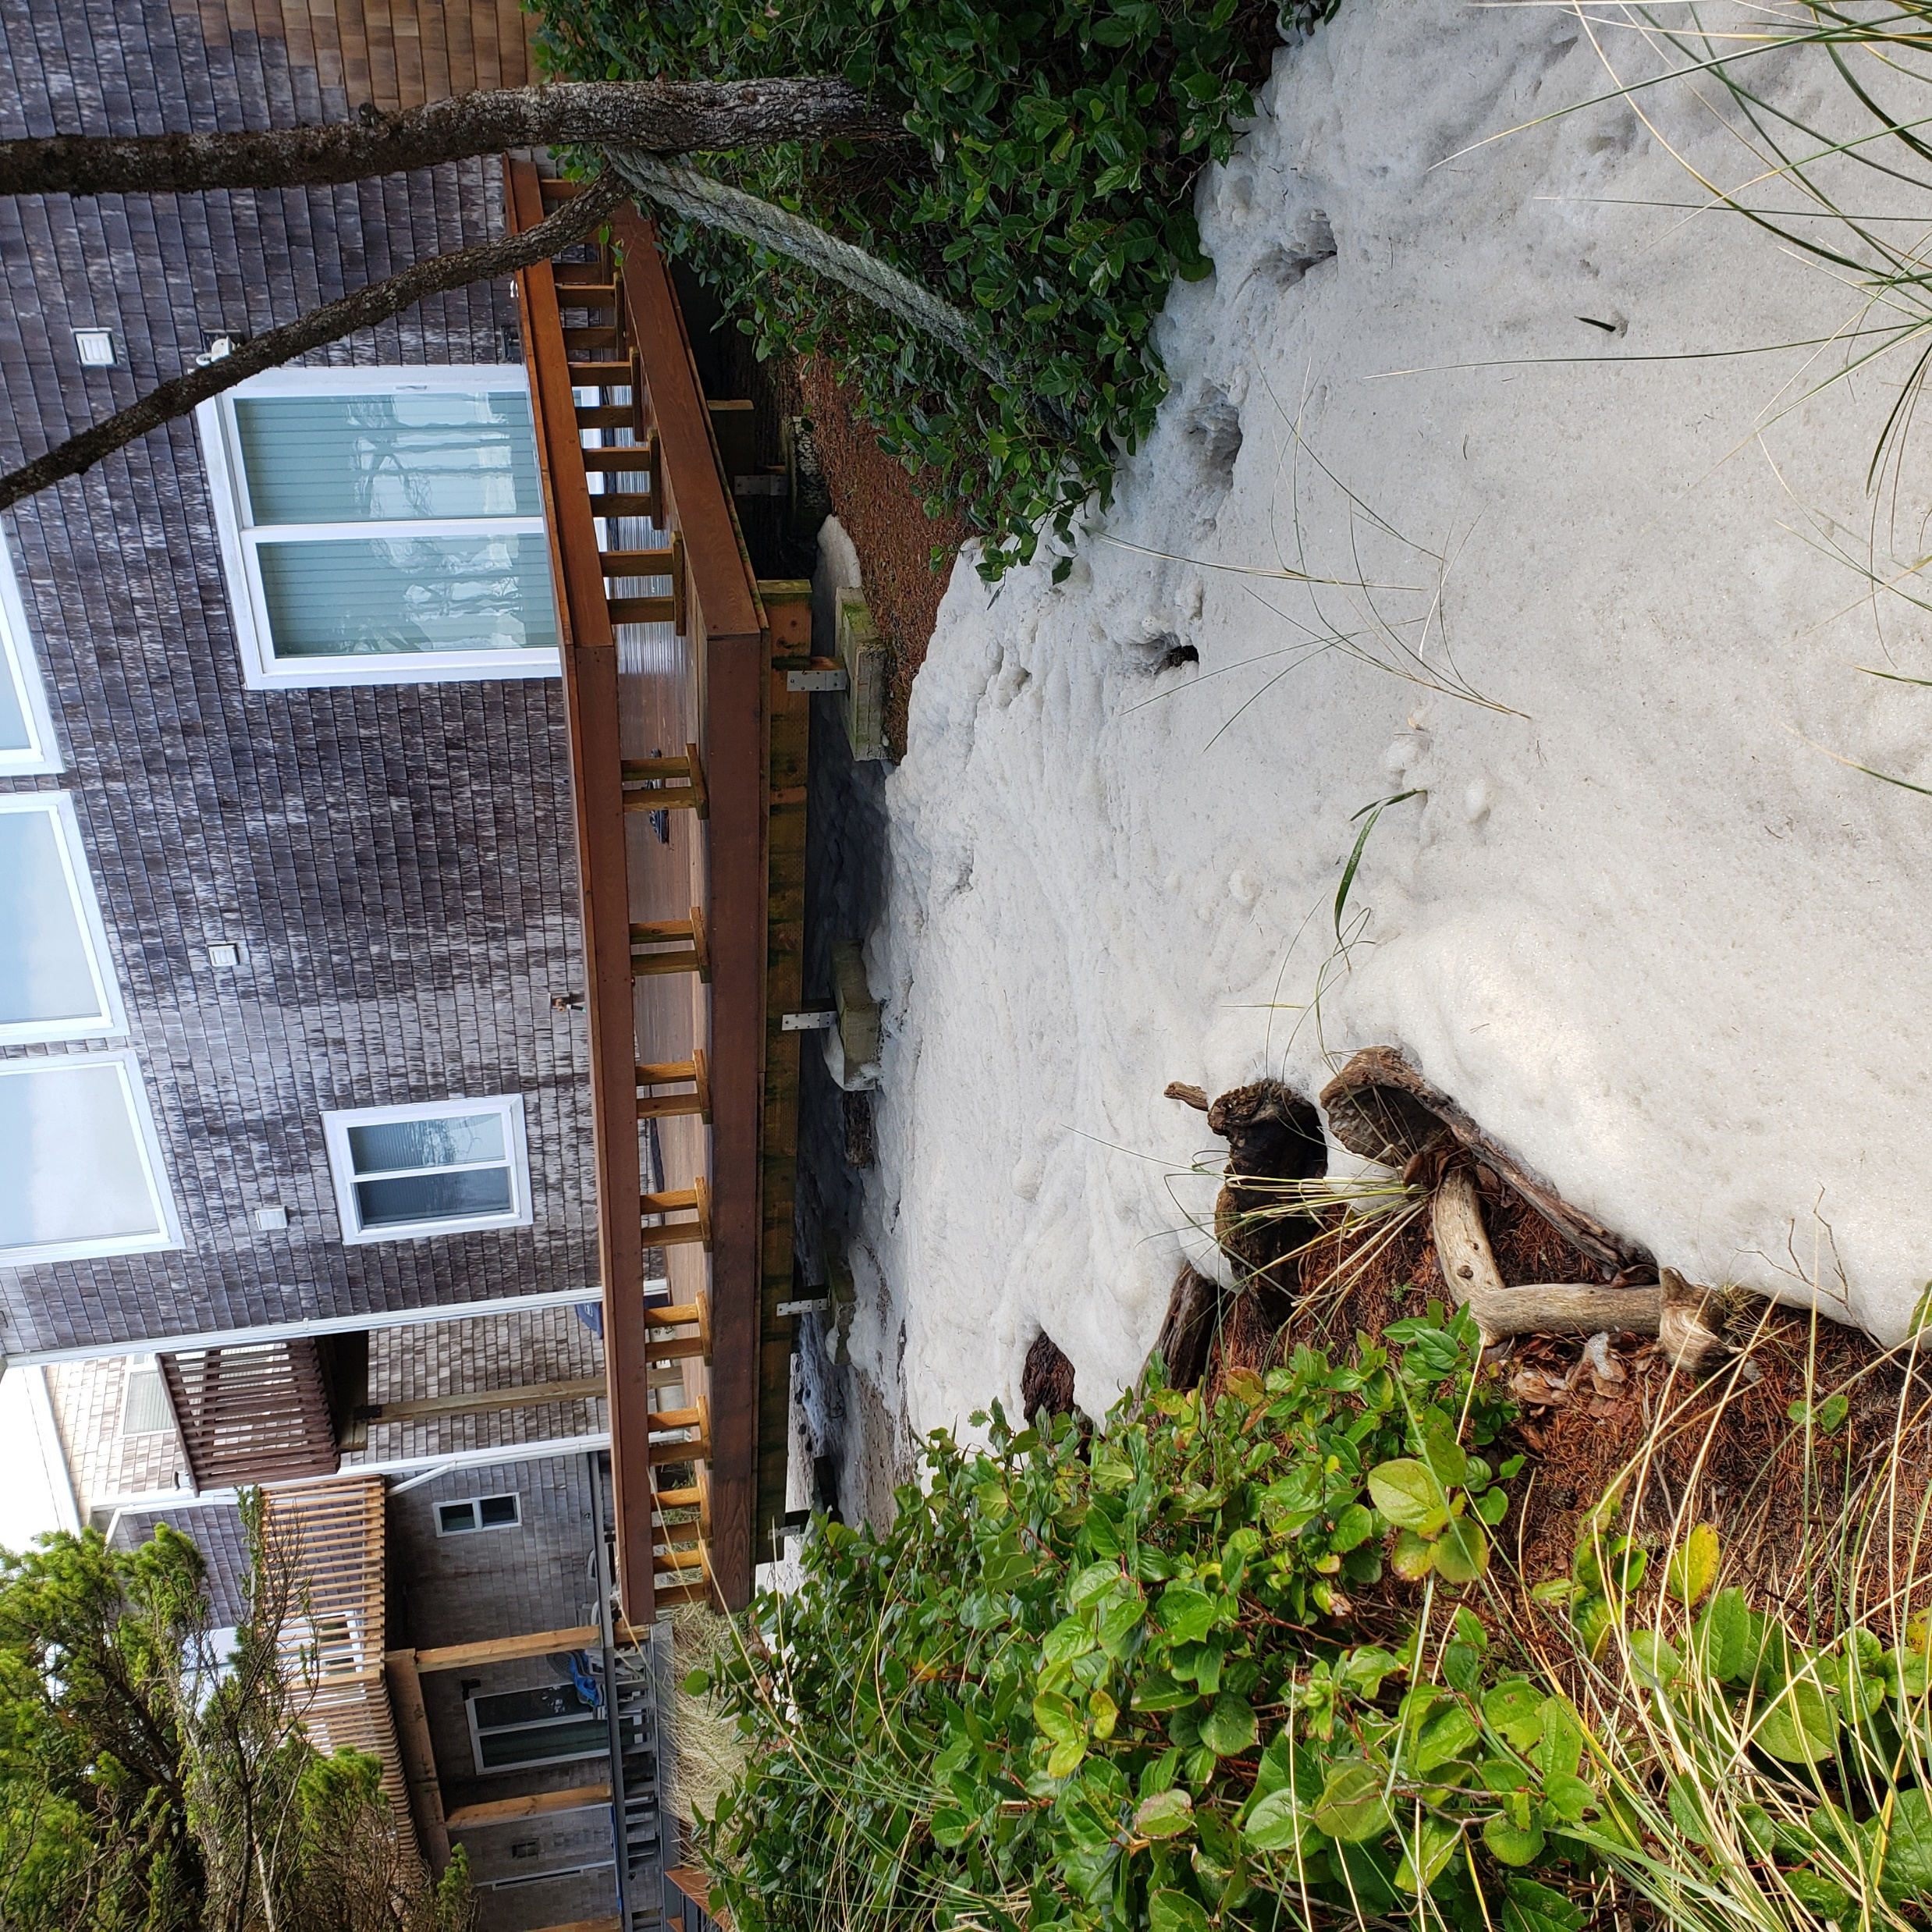

Slide 15
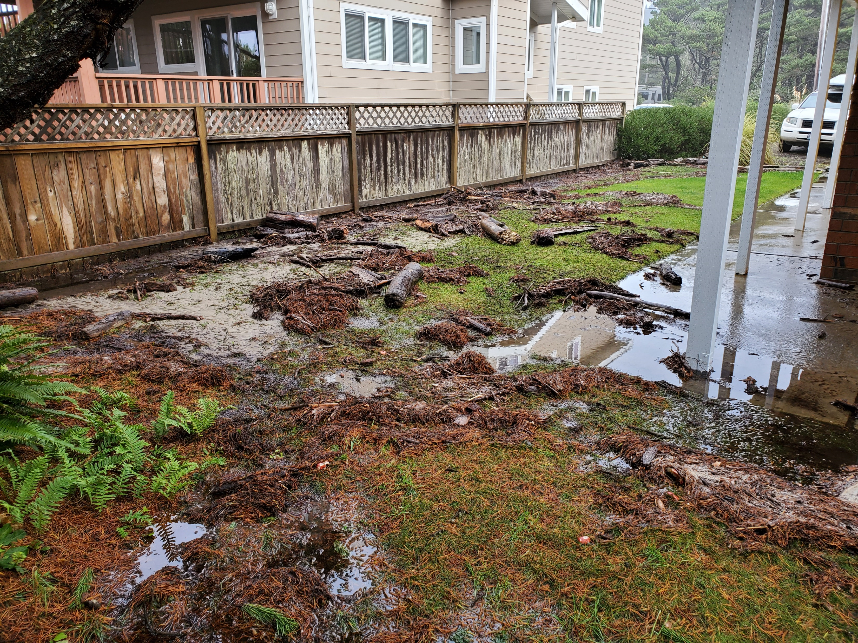

Slide 16
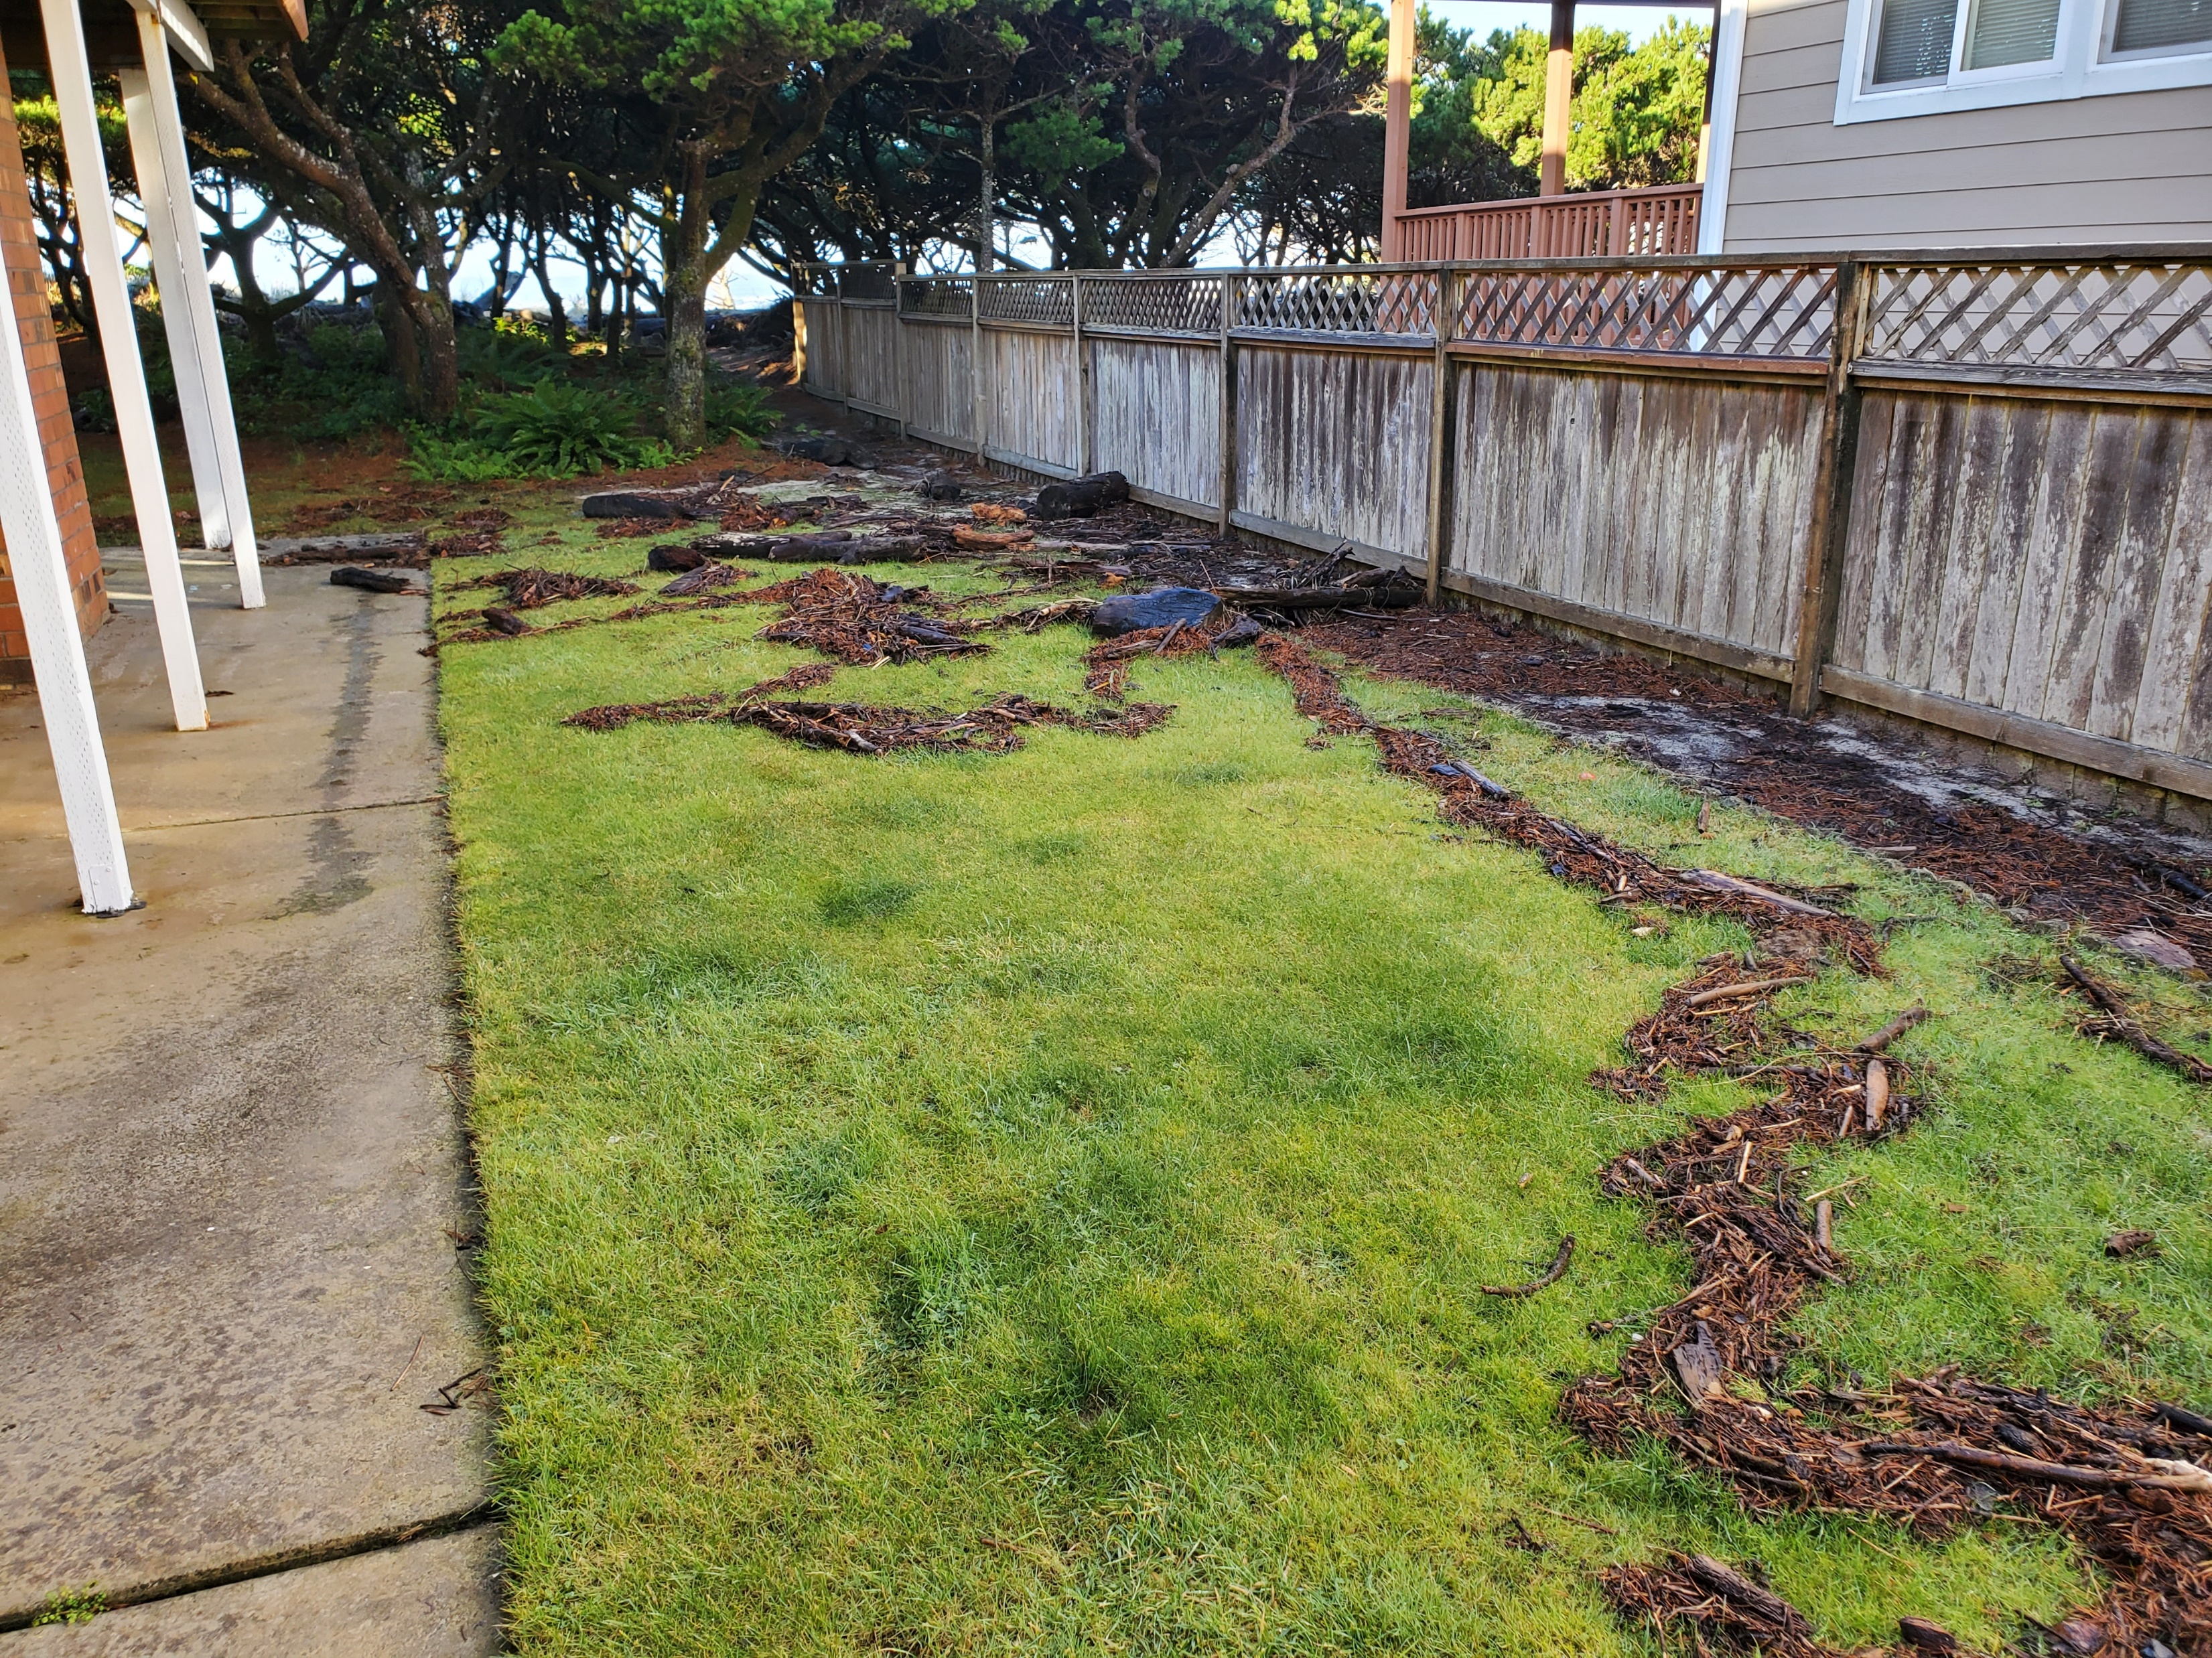

Slide 17
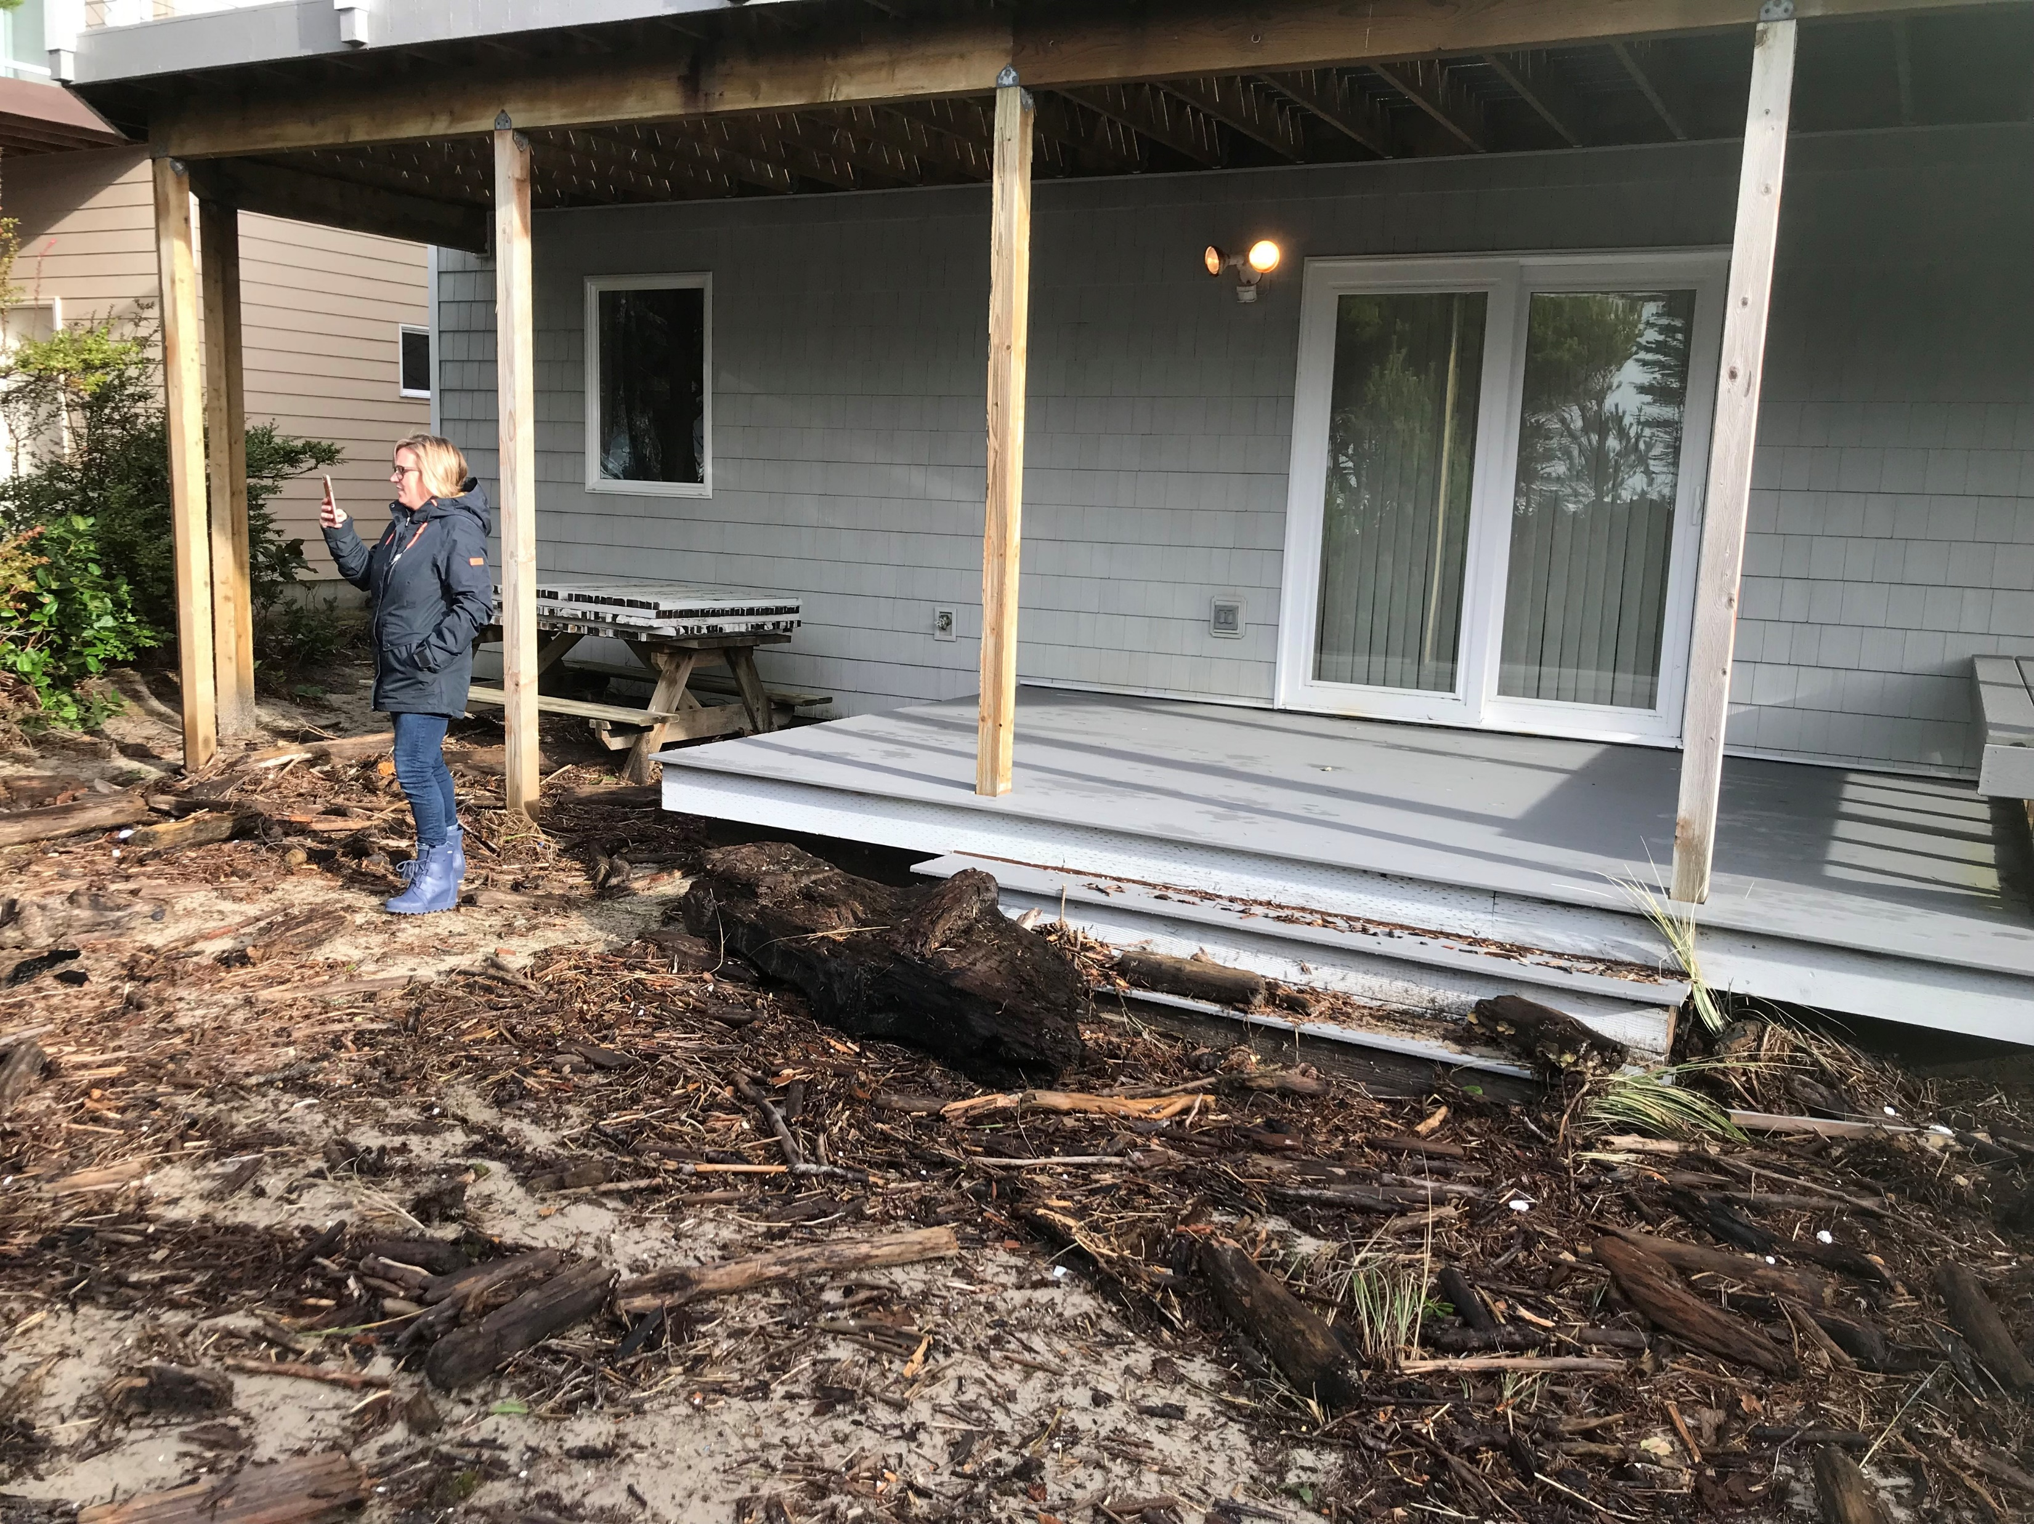

Slide 18
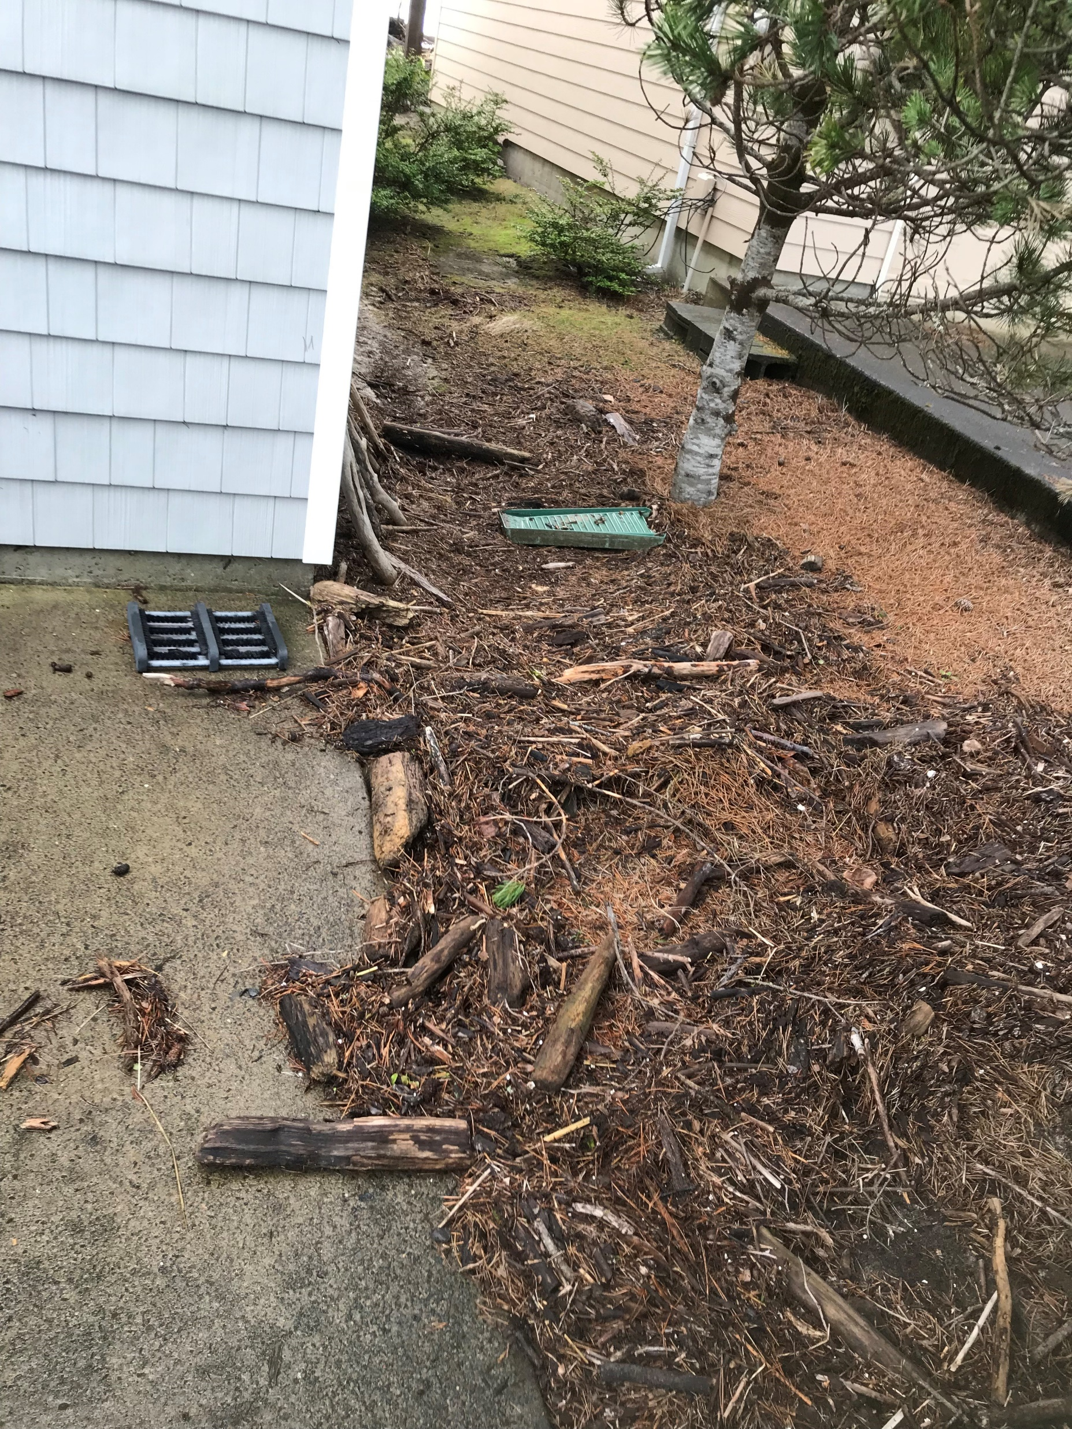

Slide 19
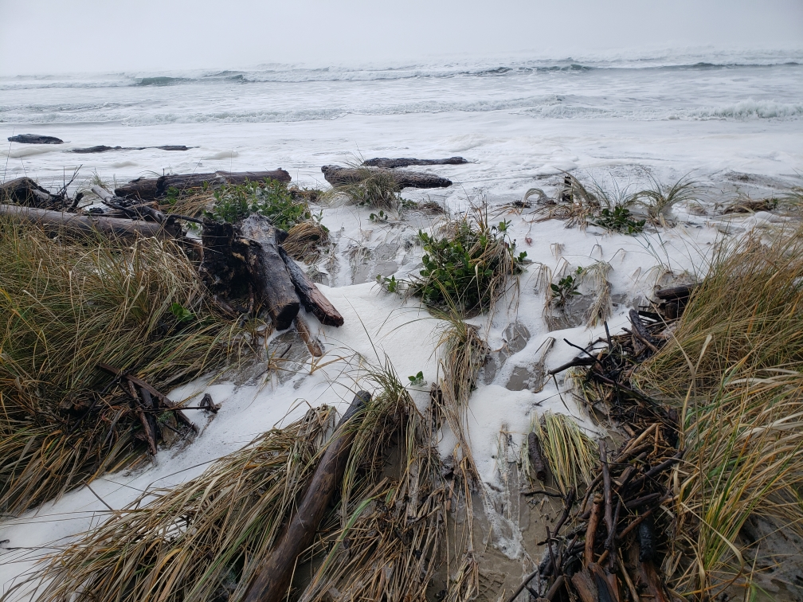

Slide 20
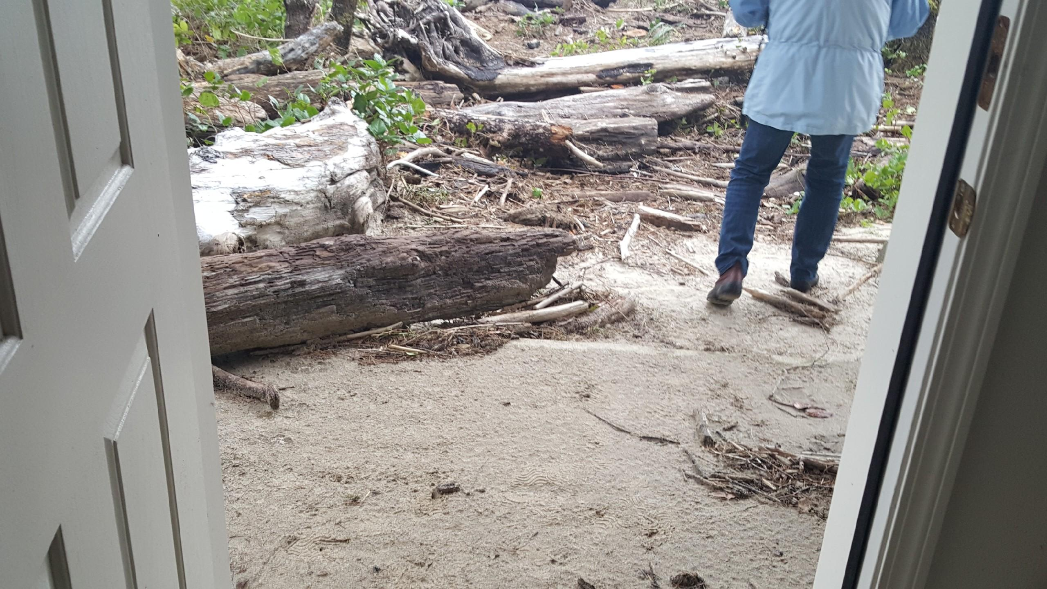

Slide 21
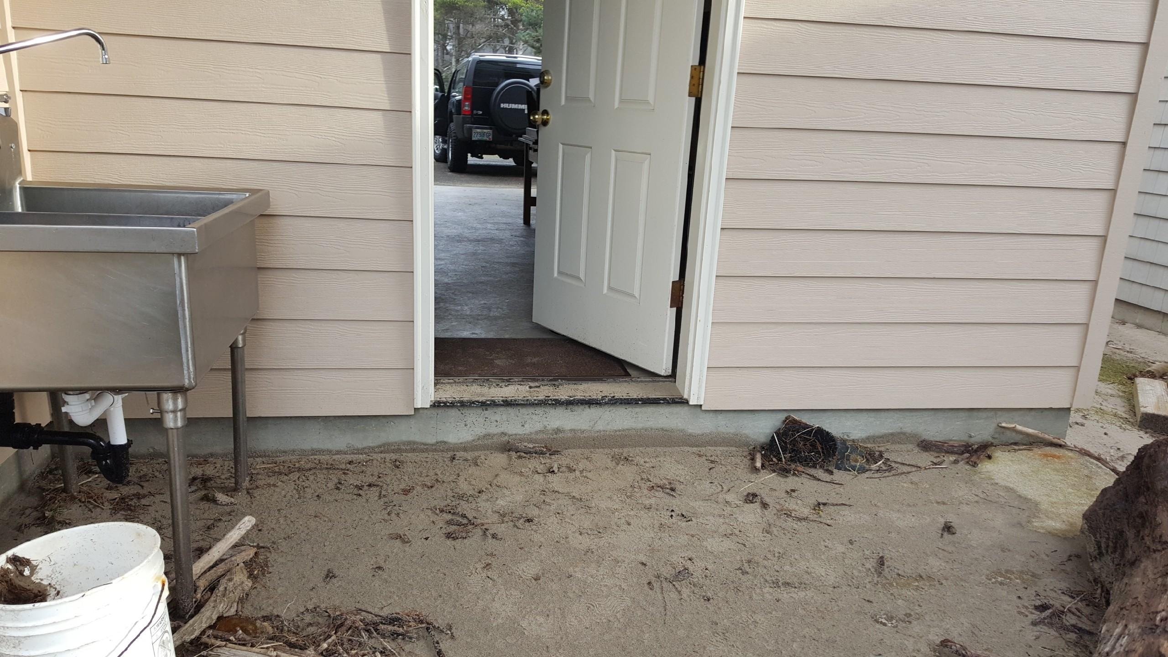

Slide 22
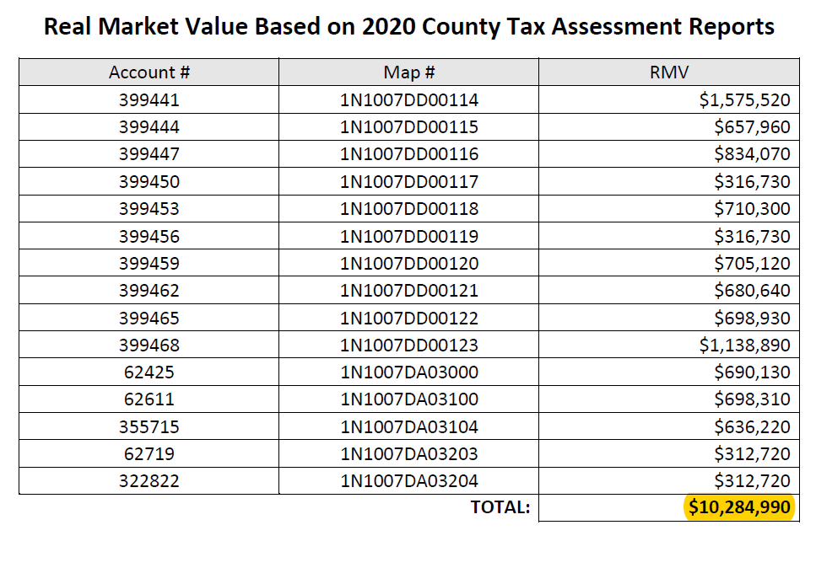

Properties and infrastructure are now in imminent peril
More than $10 million in property value at risk of being lost.
In addition to
infrastructure
(public water and sewer,
roads, utilities)

Slide 23
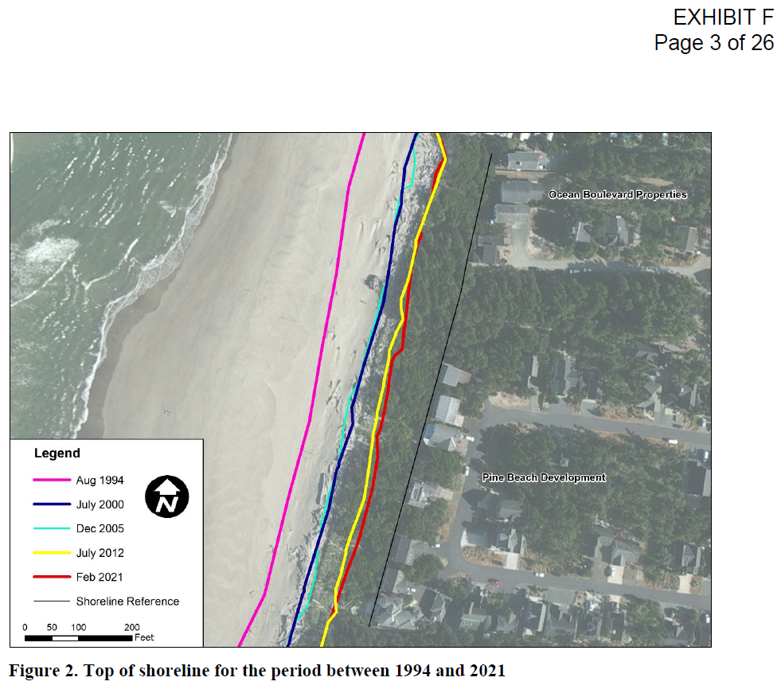
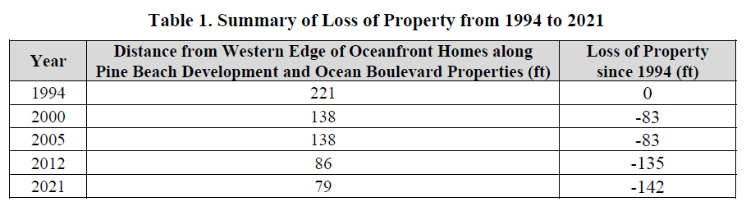
Properties and infrastructure are now in imminent peril
Between 1994-2021, the shoreline has receded 142 feet.

Slide 24
The problem explained by graphics

Slide 25
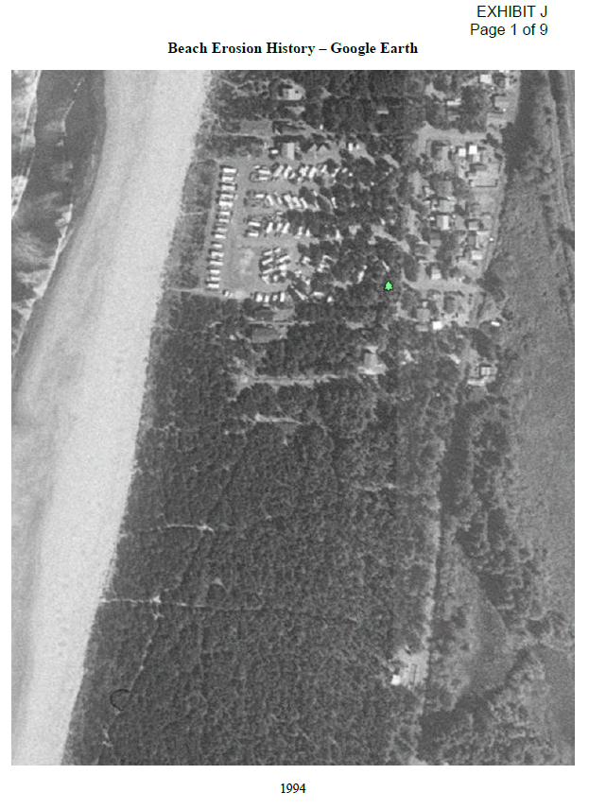
1994

Slide 26
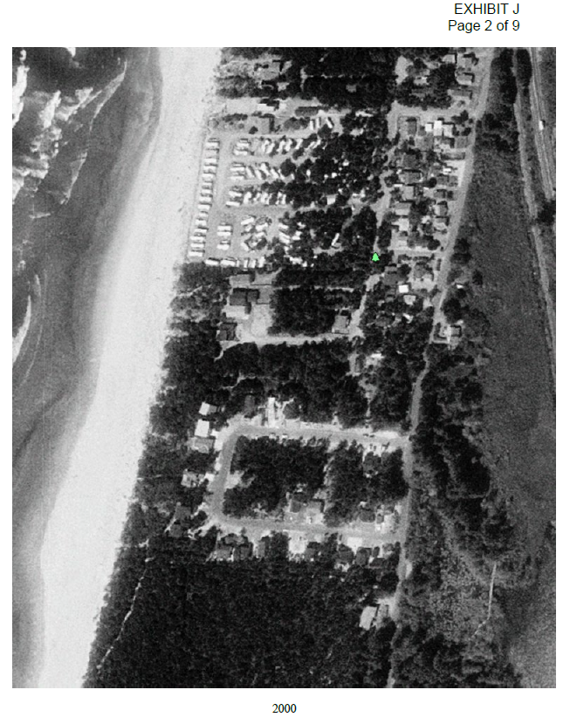
2000

Slide 27
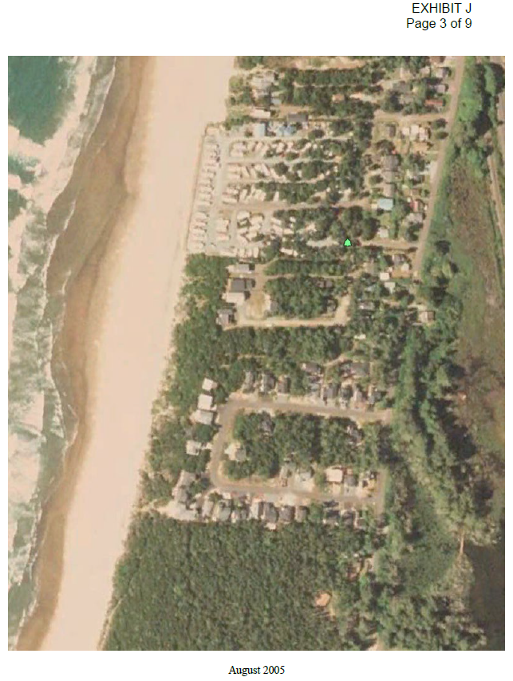
8/2005

Slide 28
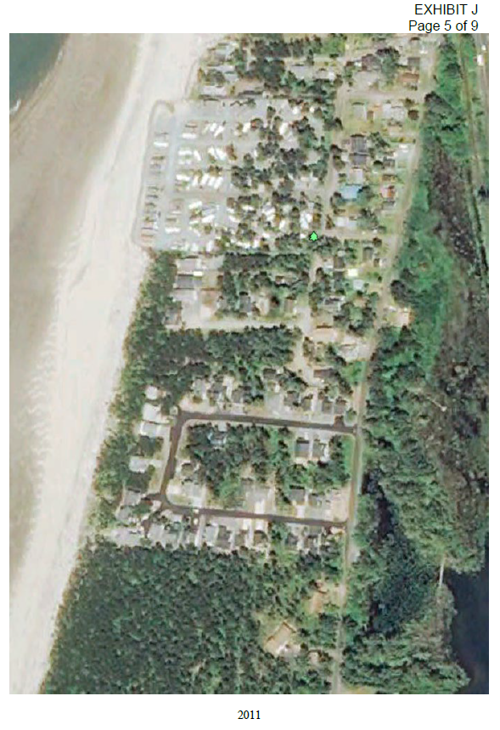
2011

Slide 29
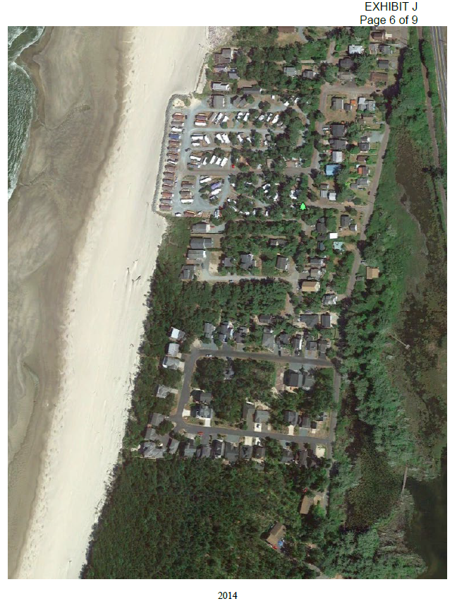
2014

Slide 30
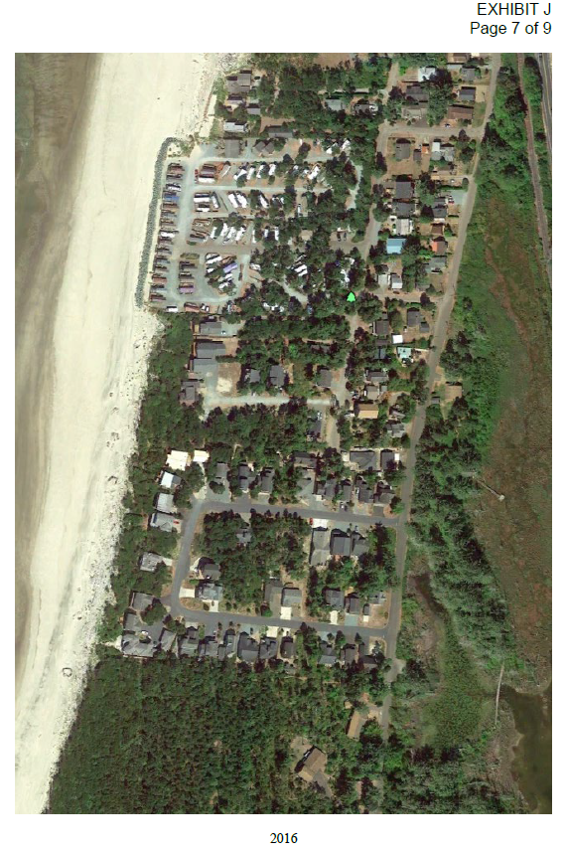
2016

Slide 31
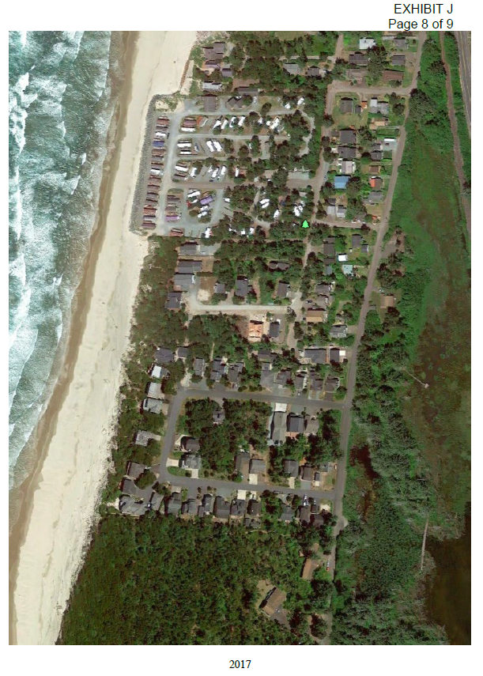
2017

Slide 32
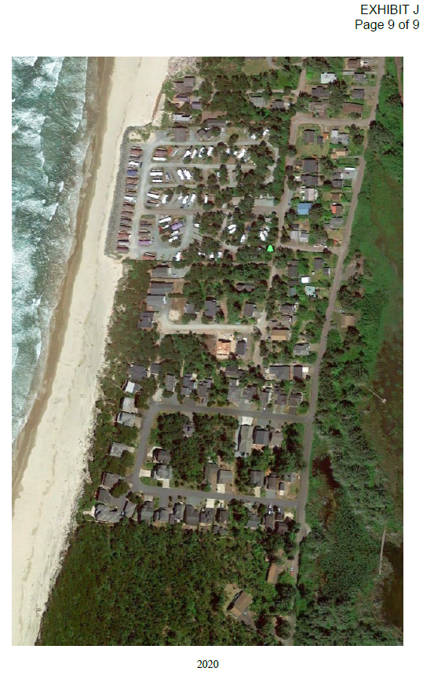
2020

Slide 33
Owners – personal responsibility
Approval authority rests entirely with Tillamook County
The beachfront protective structure (“BPS”) is not on beach.
The BPS is entirely in the backyards of the properties it will protect.
BPS is entirely east of OPRD jurisdiction – east of established vegetation/SVL;
DLCD approval not required – acknowledged urban unincorporated community with acknowledged appropriate residential development rights.
△ Tillamook County is only the approval authority - local control.

Slide 34
Legal Principles – the Easy Ones
Properties are already committed to urban residential development under acknowledged planning program that applies.
Goal 18 has two parts – the part that supports “appropriate development” and the part that prohibits development.
The properties are acknowledged under the “appropriate development” part.
The properties are committed to urban residential development because that is what the acknowledged planning program approves and requires for both the 11 built lots and the 4 that have only public infrastructure.
The easy, completely defensible decision here is to find that all the properties are entitled to a Goal 18, IM 2 and Goal 18, IM 5 exception because they are committed to the acknowledged planning urban residential development program - the “appropriate development” prong of Goal 18 - not the “prohibit development” prong of Goal 18.

Slide 35
You do not have to rely on the existing goal exceptions to make this finding
You rely only on the existing and acknowledged planning program.
There is no rule, no statute, no local code, no policy, nothing: that makes acknowledged planning programs irrelevant to whether land is committed to the existing and acknowledged planning program that governs them.
They are the most relevant planning principles of all.

Slide 36
Legal Principles – Easy Ones # 2
Built exception to Goal 18, IM 2 and 5.
The properties are built with houses and the vacant lots are built with public infrastructure.
It should be a no-brainer that at least the properties developed with houses are entitled to a “built” exception. Vacant lots that have public infrastructure at least a “committed” exception above, but also makes sense to find they are “built.”
Again, you do not have to rely upon the existing goal exceptions to make these findings.
Again, these findings are completely defensible.

Slide 37
Legal Principles – Easy Ones # 3
“Catch all” exception (DLCD likes this one) – exception to the prohibition on shoreline protection is necessary for the County to comply with Goal 7 – which requires the County to protect people and property from natural hazards.
The BPS where proposed is the only location that can protect the properties – (no evidence otherwise).

Slide 38
Legal Principles – Easy Ones # 4
OAR 660-004-0022(11) – the type of reasons exception specific to Goal 18 applies and is met.
DLCD does not claim not met – just says does not apply.
Both Goal 18, IM 2 and IM 5 prohibit development in the eroding foredune.
OAR 660-004-0022(11) applies and the County should so find.
The BPS should be approved under OAR 660-004-0022(11).

Slide 39
Legal Principle # 5 - riskier only because issue has never come up before
There are existing exceptions to Goal 3, 4, 11, 14 and 17 for the subject properties allowing residential development on the foredune they are on.
Implementing those exceptions, the Board of Commissioners approved a planning program that LCDC/DLCD acknowledged that commits the properties to residential development in an acknowledged urban unincorporated community.
“Acknowledged” means that the planning program for the subject properties complies with all state goals – including Goal 18.
When the foredune became hazardous, the scope of the existing exceptions still allows the residential development on the foredune that became hazardous.
Therefore, the properties’ existing exceptions also serve as exceptions to Goal 18, IM 2 that prohibits residential development on eroding foredunes.

Slide 40
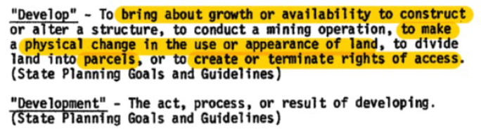
Legal Principle #6 –riskier only because it hasn’t come up before
Properties are allowed to have BPS if they were “developed” on Jan 1, 1977 under definition of “developed” that existed until 1984:
Both Pine Beach (original plat) and George Shand tracts were “developed” under this definition.
That means they are entitled to approval of the requested BPS.

Slide 41
Legal Principle #7 – risky only because it has not come up before
  The version of Goal 18 IM 5 now in effect: shoreline protection allowed for property that was “developed” on January 1, 1977. “Developed” “means houses *** and vacant subdivision lots which are physically improved through construction of streets and provision of utilities to the lot ***.”
  George Shand Tracts and Pine Beach subdivision meet this definition – there was “provision of” water from the Watseco Water District predecessor and streets ran to GS tracts and Pine Beach subdivision on 1/1/1977.
  That means they are entitled to approval of the requested BPS.

Slide 42
The County should make affirmative findings on all approaches because the law and evidence supports doing so
Applicants are willing and enthusiastic to work with County to help with findings as desired.

Slide 43
DLCD is Wrong:
The 1932 Pine Beach Plat was NOT vacated.
Subdivision titled “George Shand Tracts” is and always has been a “subdivision” under Oregon law.
The properties DO have a Goal 17 exception.
The property is NOT Goal 18 “resource land.”
No law whatsoever prohibits County approval of the Applicants’ request.

Slide 44
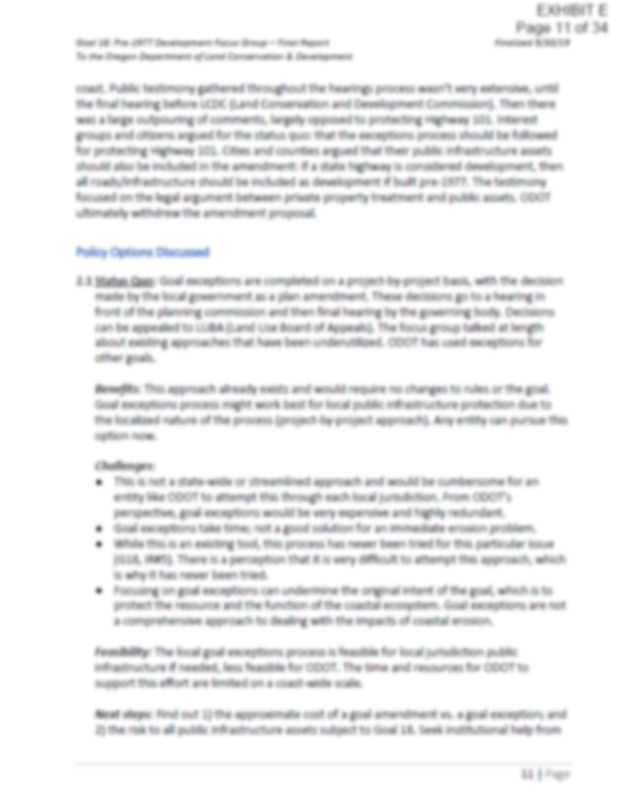

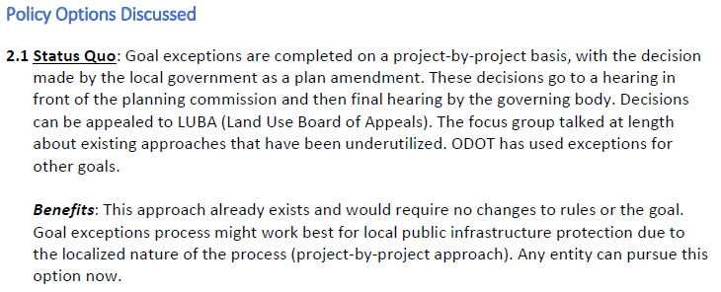
DLCD’s letter: inconsistent with its published position

Slide 45
Requested Planning Commission Decision:
The Subject Properties qualify for a “committed” and a “built” exception because they are “built” and “committed” under an acknowledged planning program that commits them to residential development. As a result, the Subject Properties are entitled to shoreline protection under Goal 18, Implementation Measure 5.
The Subject Properties qualify for the “catch all” reasons exception DLCD prefers. It is impossible for the County to comply with Goal 7’s requirement to protect life and property if County refuses to allow life and property to be protected from natural hazards. The circumstances are unique: the properties are acknowledged to comply with the “appropriate development” prong of Goal 18, and it is only the fact that the ocean reversed 70 years of prograding to aggressive retrograding, that triggers Goal 18, Implementation Measure 2. The Subject Properties are entitled to shoreline protection under Goal 18, Implementation Measure 5.

Slide 46
Requested Planning Commission Decision:
The Subject Properties qualify for a reasons exception under OAR 660-004-0022(11), because both Goal 18, Implementation Measures 2 and 5 prohibit foredune development and the proposed BPS meets all OAR 660-004-0022(11) standards. The Subject Properties are entitled to shoreline protection under Goal 18, Implementation Measure 5.
OAR 660-004-0022(11) specifically allows exceptions to prohibitions on foredune development in Goal 18 IM 5 and Goal 18 IM 2.

Slide 47
Requested Planning Commission Decision:
The acknowledged residential development/urban unincorporated community planning program is based upon existing exceptions to Goals 3, 4, 11, 14 and 17 and is acknowledged to comply with Goal 18 as “appropriate development.” As a result, those exceptions that allow residential development of the Subject Properties are also an exception to Goal 18, Implementation Measure 2, to allow that residential development if the foredune becomes subject to ocean overtopping/undercutting. That means there is an existing exception to “(2) above” and so the properties are entitled to shoreline protection under Goal 18, Implementation Measure 5.
The Subject Properties were “developed” on January 1, 1977, under the definition of “developed” until 1984 when it changed. The subdivisions have a vested right to be protected under those standards under the common law of vested rights as well as ORS 215.427(3). Therefore, the properties are entitled to shoreline protection under Goal 18, Implementation Measure 5.
The Subject Properties were also “developed” on January 1, 1977, under the definition of development that now applies because they were platted subdivision lots with the provision of utilities (water was available from the Watseco Water District and in fact one of the George Shand Lots, TL 2900, connected to it in 1974) and was served by roads.

Slide 48
PC Should find that this Request is Unique
At the time that the Pine Beach subdivision was replatted (1994) and the George Shand tracts were initially platted (1950) and at the time when all the houses were built, the ocean was PROGRADING – depositing sand, not taking it away.
Instead, the homes were more than 237 feet away from the surveyed statutory vegetation line and further still from the ocean.
Now the statutory vegetation line is at the ocean.
A large vegetated “common area” was platted oceanward of the Pine Beach lots.
That “common area” is now entirely a dry sand beach.
Shoreline protection is necessary because the ocean has dramatically shifted course from where it had been for more than 70 years.

Slide 49
Planning Commission Should find that the Developers Did Everything Right
George Shand Tracts (Ocean Blvd. properties) platted in 1950.
Pine Beach replatted in 1994.
Homes seeking BPS here were constructed beginning in 1989.
All development strictly avoided, by hundreds of feet, foredunes subject to overtopping and undercutting.
When constructed, there had been a 70-year period of ocean progration – depositing of sand and adding land.
Planning commission should find it is inappropriate to punish the owners now that unexpected natural hazards have stricken and taken out natural foredune vegetation.

Slide 50
Pine Beach’s BPS will blend into the natural coastal landscape
Pine Beach BPS is in owners’ backyards.
Will not be on the beach.
The BPS will be covered in excavated sand and replanted with native beach grasses, shrubs and trees.
Will be maintained annually by owners.
Will be periodically replenished with sand and replanted with native vegetation because the owners want to look at a beautiful seascape.

Slide 51
Revetment Details
Harms no one per engineering analysis in the record
Best chance of reestablishing natural vegetation
Maintains existing beach accesses
Approx. size: 6’ thick 30’ wide rock revetment; maximum height 3’ above ground level
Covered in excavated sand, replanted with native beach grasses
Some confusion about the existing beach accesses. Whatever they are they will remain and not be blocked or impeded in any way.

Slide 52
Thank you
Questions?

