Slide 1
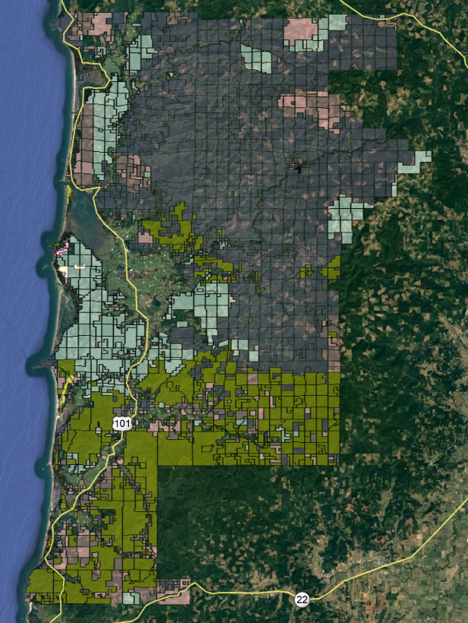
Road Department
PC/Woods CAC
February 19, 2022
Notes:
Timber Property/ GIS

Slide 2
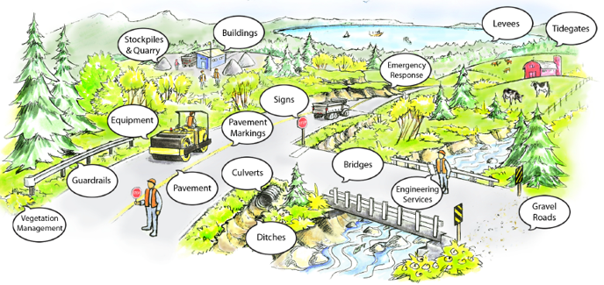
Transportation Infrastructure
County Road
Advisory Committee
(CRAC)
Notes:
CRAC Reviewed & recommends budget approval

Slide 3
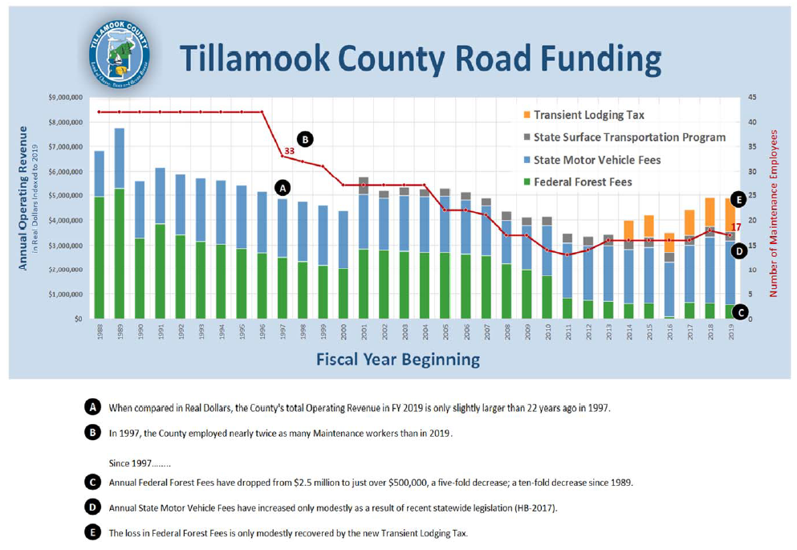
Historic Trends
Notes:
W/O beginning Balance

Slide 4
Revenue
Changes
IIJA – Stabilized Federal Timber Revenue to 2017 dollars
Directly increases Road Operating Revenue by ~$22k

Slide 5
Challenges
Staffing
Chips
Russia/Ukraine
Budget
Geography
Storms

Slide 6
Waterways
One Bridge per Three Miles
20-ft Federal Bridges
<20-ft Local Bridges
Rain Events
Culverts
4,000
1/3 poor to failing

Slide 7
Emergency Bridges
Six Posted at 3 or 10 tons
Fagan – Bridge over Bridge
Moss Creek – Bridge over Bridge
Minich – Deck Replacement
Yellow Fir – Deck Reduction
McKinster – Bridge Removal
Lagler – Rail car over bridge

Slide 8
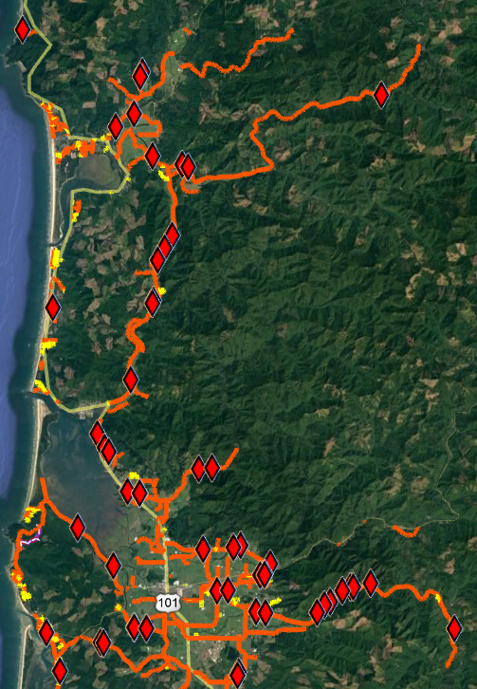
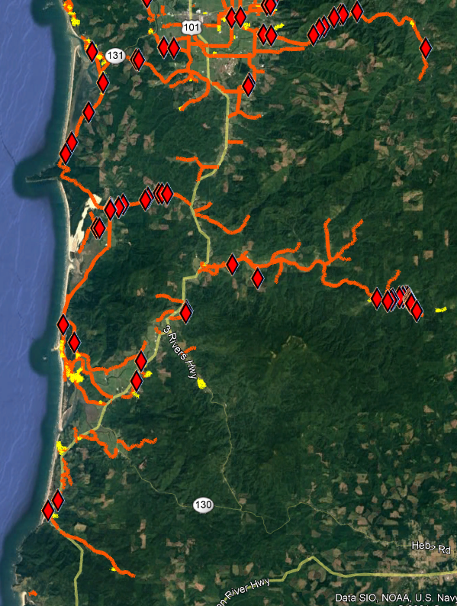
Failing Culverts >24”
Notes:
North left / South right
Inventory Ongoing– 4000 culverts/ 1000 failing
Staff field data collected/ GIS process – Wendy help
No GIS analytics (experience) – manual calcs
Rain / age / undersized / fish…

Slide 9
Salmon Superhwy
Tillamook Estuary Partnership
Nestucca Neskowin Sandlake Watershed Council

Slide 10
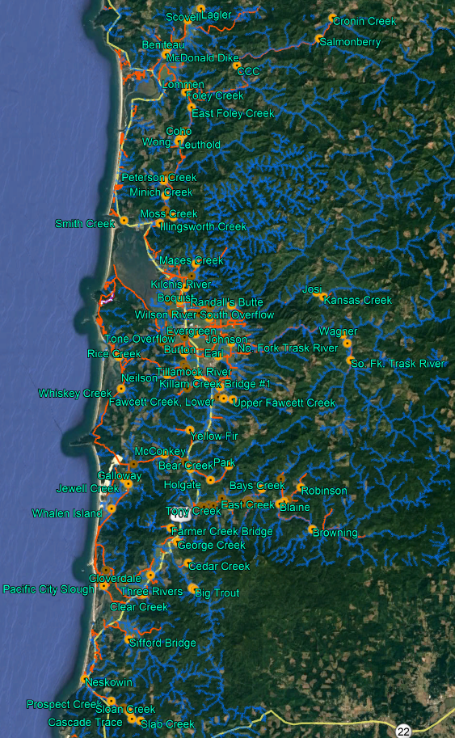
1 bridge every 3 miles

Slide 11
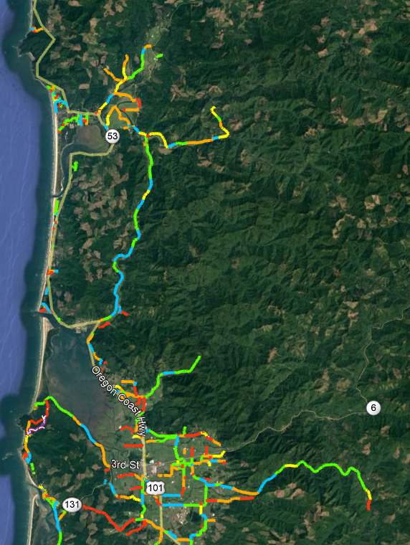
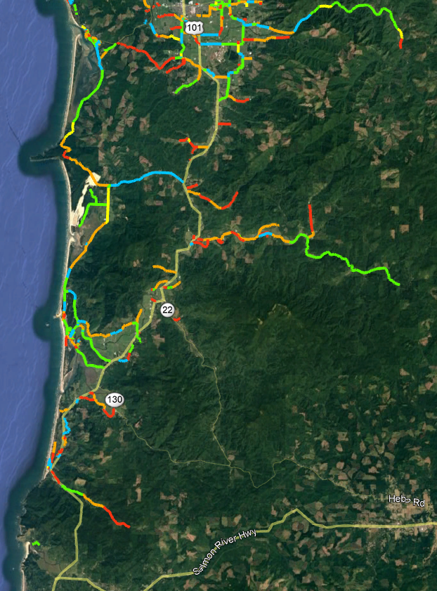
Road Conditions
2020

Slide 12
Paving List - Criteria
Funding Partner
Repeating / Consistent Problems
Sole Access < 3 Homes / Businesses
Sole Access > 3 Homes / Businesses
Local Support
Safety Concerns
Budget Adjustment
Road Classification
First Responder Request
Pavement Condition Inventory
Remaining Service Life
Importance to Business
Heavy Vehicle Loading
Tie with other Projects

Slide 13
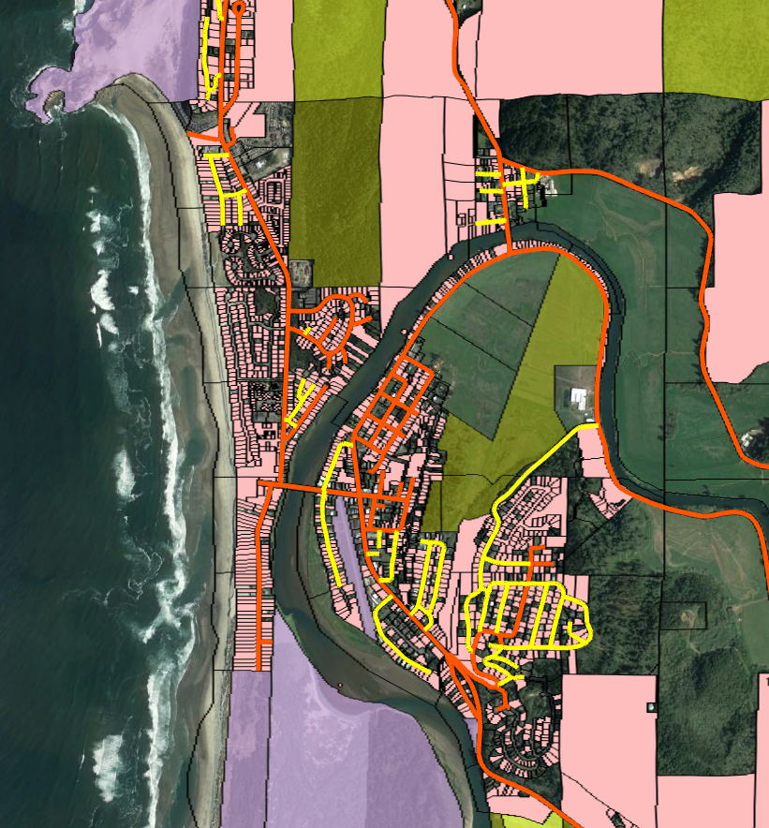
Pacific City
Ownership Maintenance

Slide 14
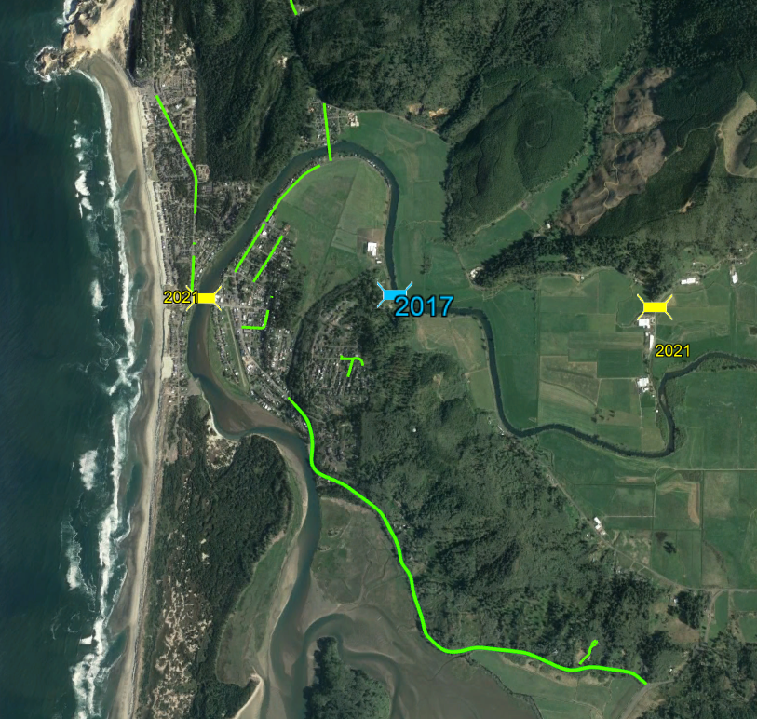
Pacific City
Roadwork

Slide 15
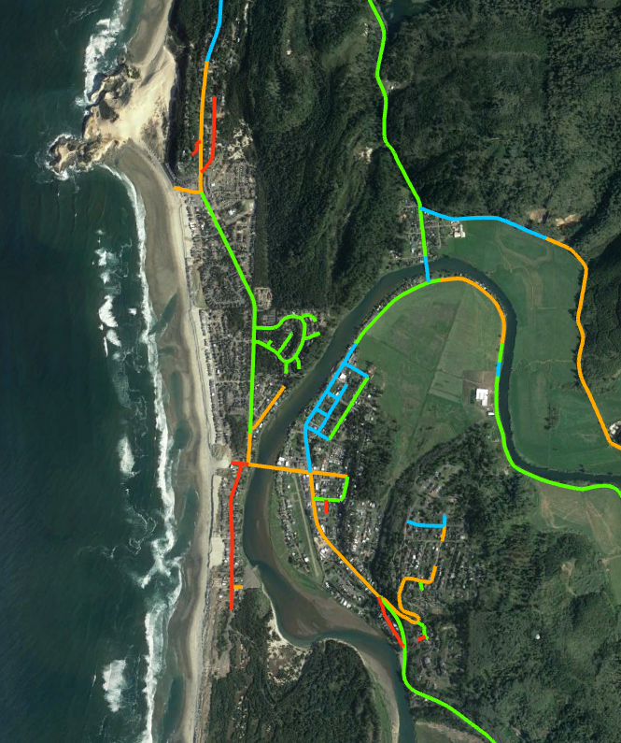
Pacific City
Road Conditions
Paving
Brooten/Pacific
Limited to $125k
Resort Drive
Deferred
Circle Drive – Reverse Crown Drainage
Sunset Drive – Location of Road

Slide 16
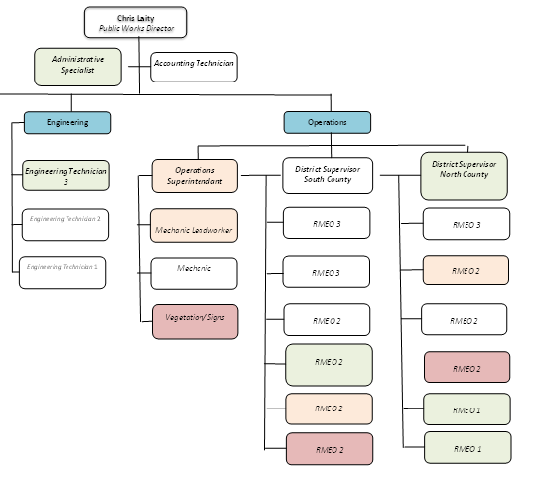
Staffing

Slide 17
Comments
Questions

